Slide 1
Artificial Intelligence
UNIT-1
Dr.SP.Rajamohana
Assistant Professor
Department of Computer Science
School of Engineering and Technology
Pondicherry University
Karaikal Campus.

Slide 2
Outline
What is Artificial Intelligence?
Foundations of AI
History of AI
Applications of AI
Agents and Environments
Rationality
PEAS (Performance Measure, Environment, Actuators, Sensors)
Environment Types
Agent types

Slide 3
What is Artificial Intelligence?
Computer Science
Methods for applying computers to problems
Study of the fundamental limits of computation
Artificial Intelligence
Methods for applying computers to problems that require “intelligence”
Study of the fundamental limits of “intelligent” behavior by computers

Slide 4
Overview of Artificial Intelligence
Artificial
Produced by human art or effort, rather than originating naturally.
Intelligence
is the ability to acquire knowledge and use it"
So AI was defined as:
AI is the study of ideas that enable computers to be intelligent.
AI is the part of computer science concerned with design of computer systems that exhibit human intelligence(From the Concise Oxford Dictionary)

Slide 5
What is AI?
Intelligence:
capacity to learn and solve problems”
(Webster dictionary)
the ability to act rationally
AI is the part of computer science concerned with design of computer systems that exhibit human intelligence
It is a branch of Computer science by which we can create a intelligent machines which will behave like a humans, think like a humans, able to make decisions
Views of AI fall into four categories:
Systems that act like humans
Systems that think like humans
Systems that act rationally
Systems that think rationally
In this course, we are going to focus on systems that act rationally, i.e., the creation, design and implementation of rational agents.

Slide 6
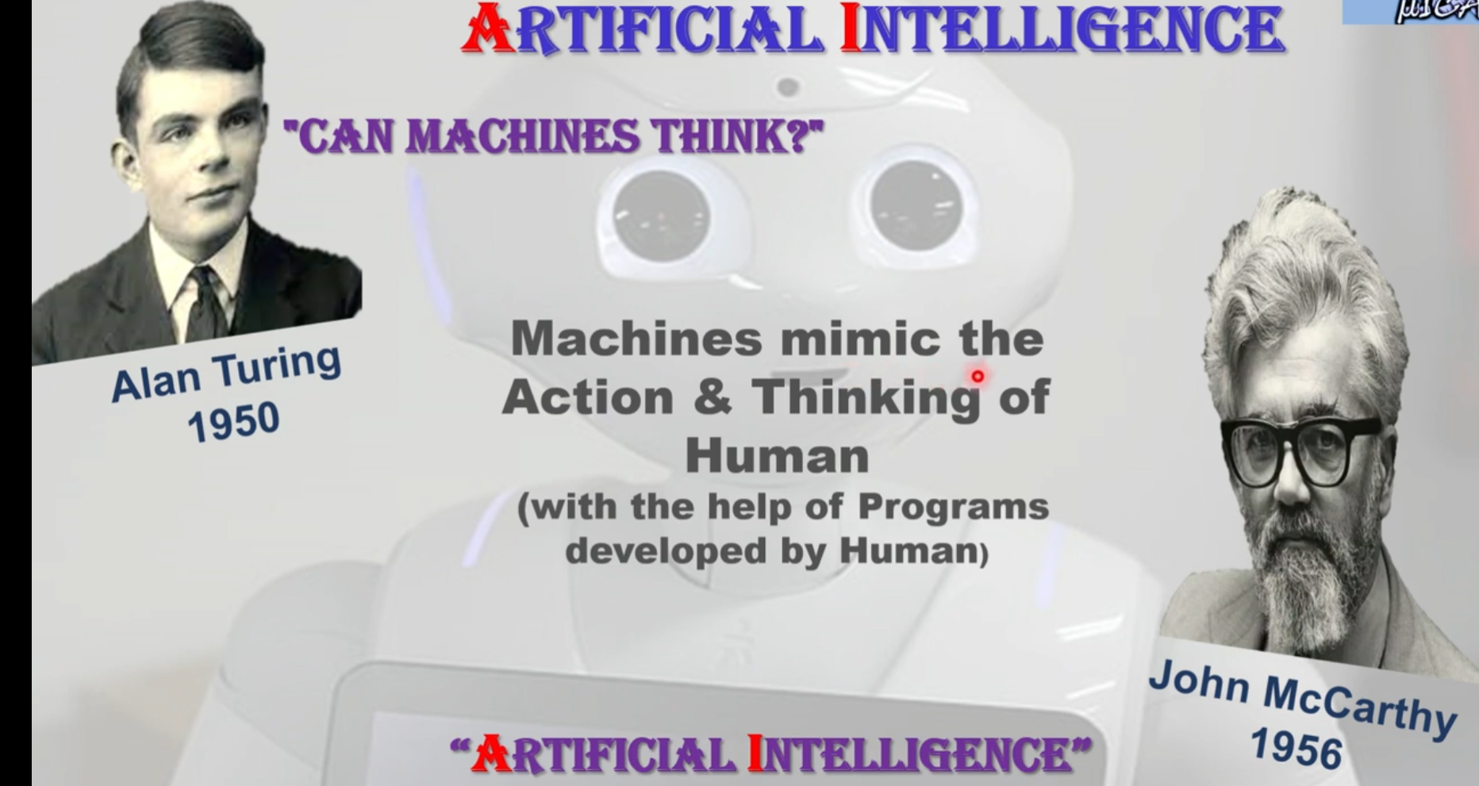
Artificial Intelligence

Slide 7
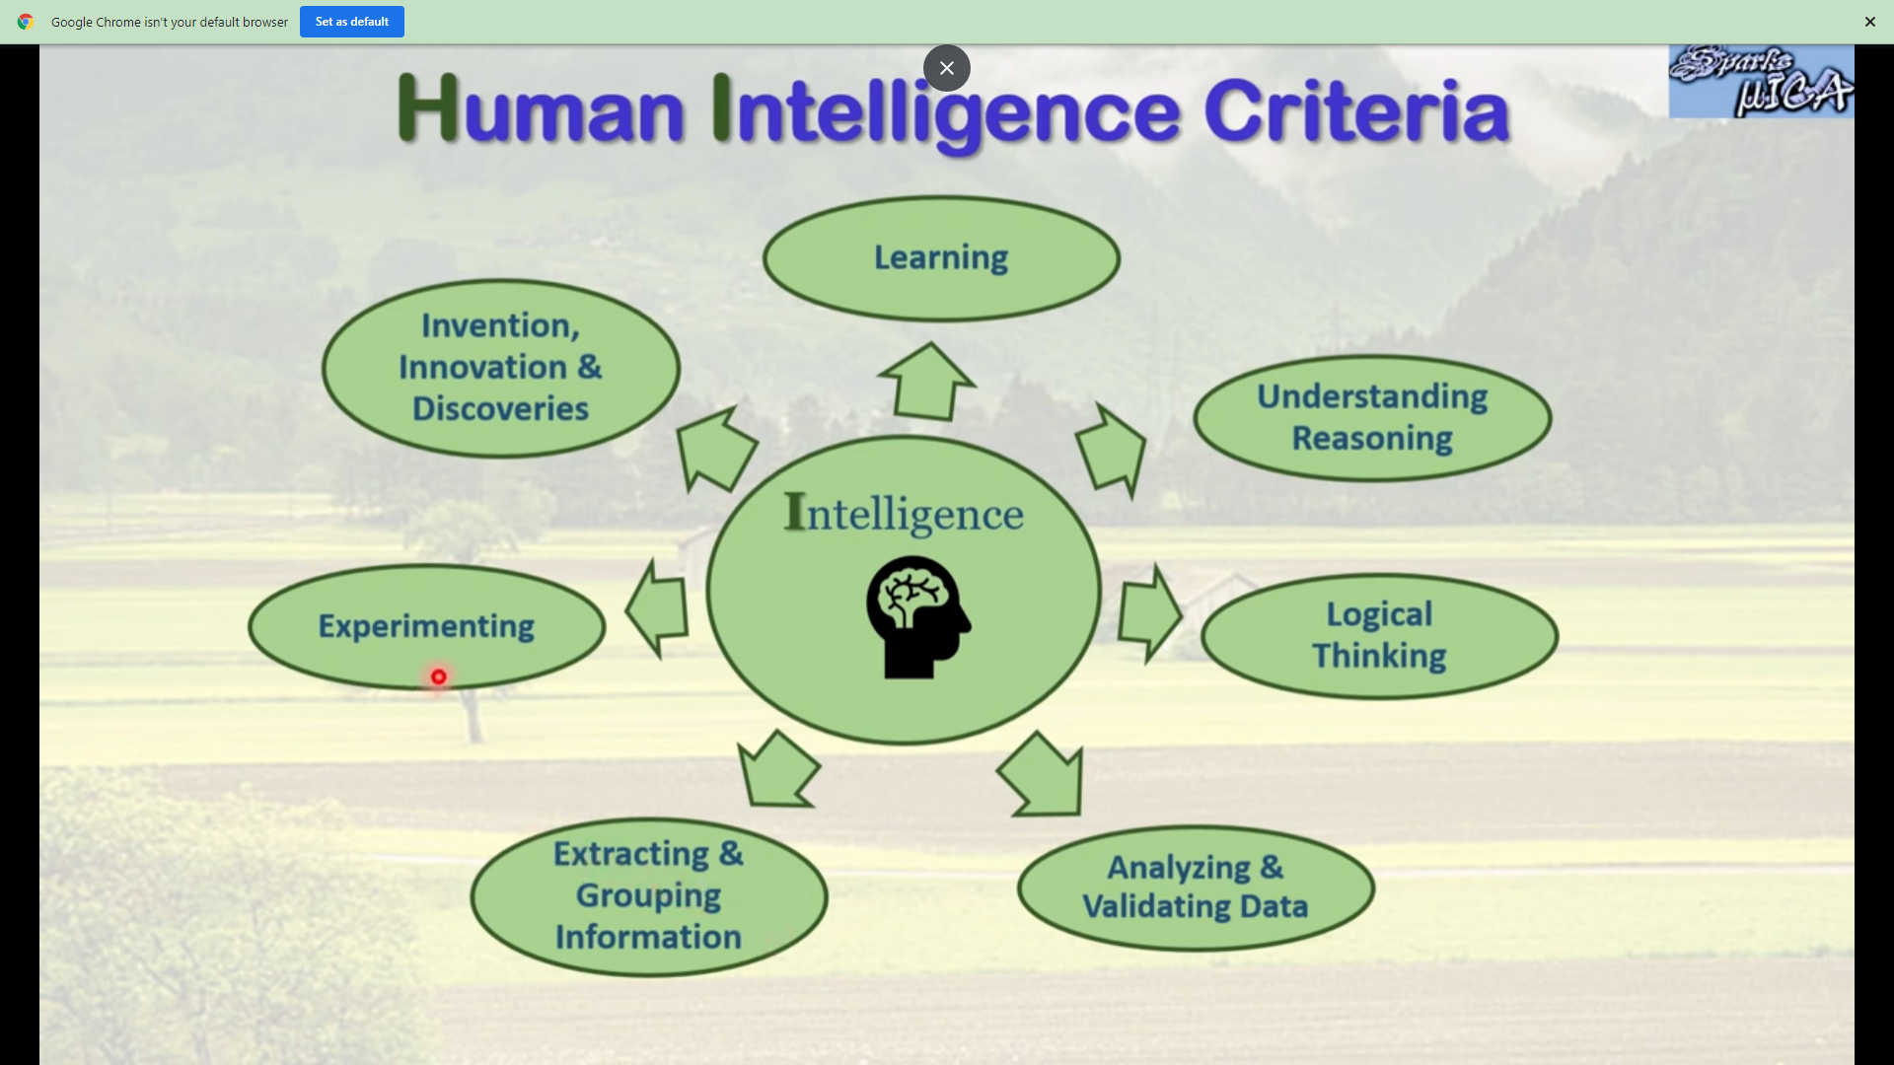
Human Intelligence

Slide 8
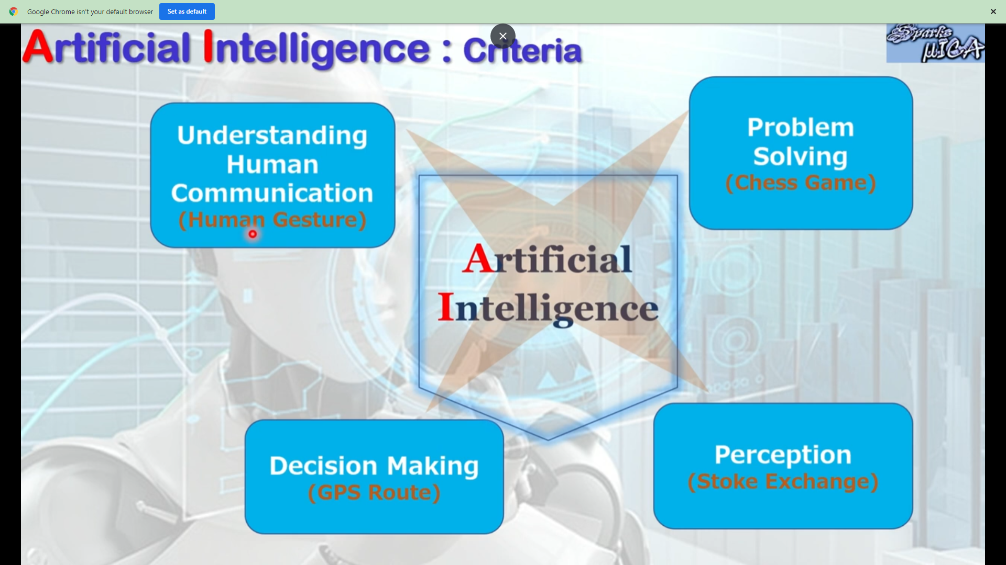
AI Criteria

Slide 9
What is Artificial Intelligence ? Definition -1
Systems that think like humans
Systems that think rationally
THOUGHT
Thinking humanly
Thinking rationally
2
3
Systems that act like humans
Systems that act rationally
BEHAVIOUR
Acting humanly
Acting rationally
1
4
HUMAN
RATIONAL

Slide 10
What is Artificial Intelligence?
Definitions of AI vary
Artificial Intelligence is the study of systems that
think like humans
think rationally
act like humans
act rationally

Slide 11
Strong AI Vs Weak AI
Strong AI
Create a robot which is autonomous, thinks for itself, makes its own decisions, can deliberate about its own thoughts, can learn and adapt to new situations and can communicate with humans through the use of language.
Weak AI
To build a computer program that simulates a particular intelligent activity, e.g. playing chess.

Slide 12
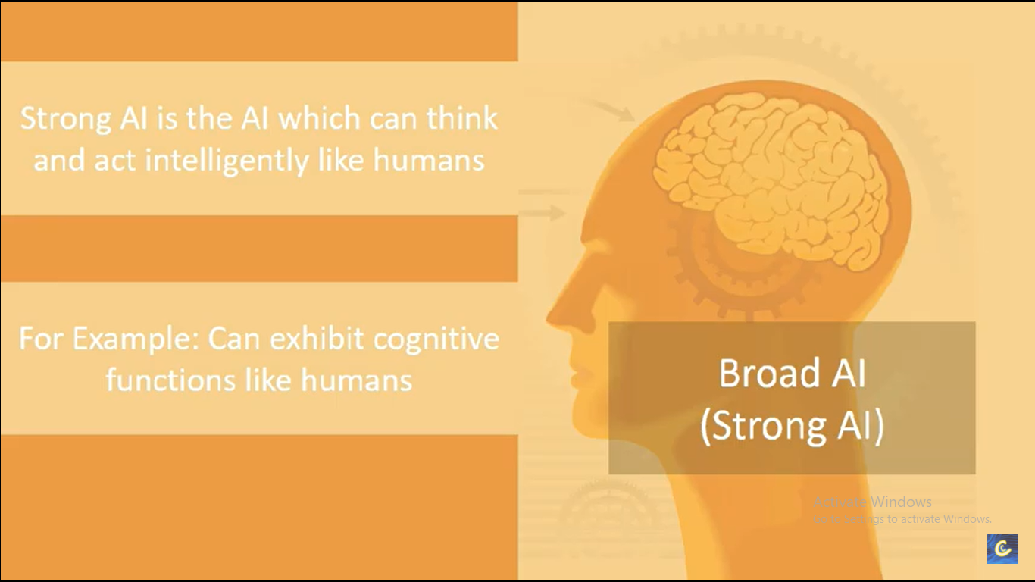
Strong AI
Notes:
https://www.youtube.com/watch?v=rtPY1BJUbSk

Slide 13
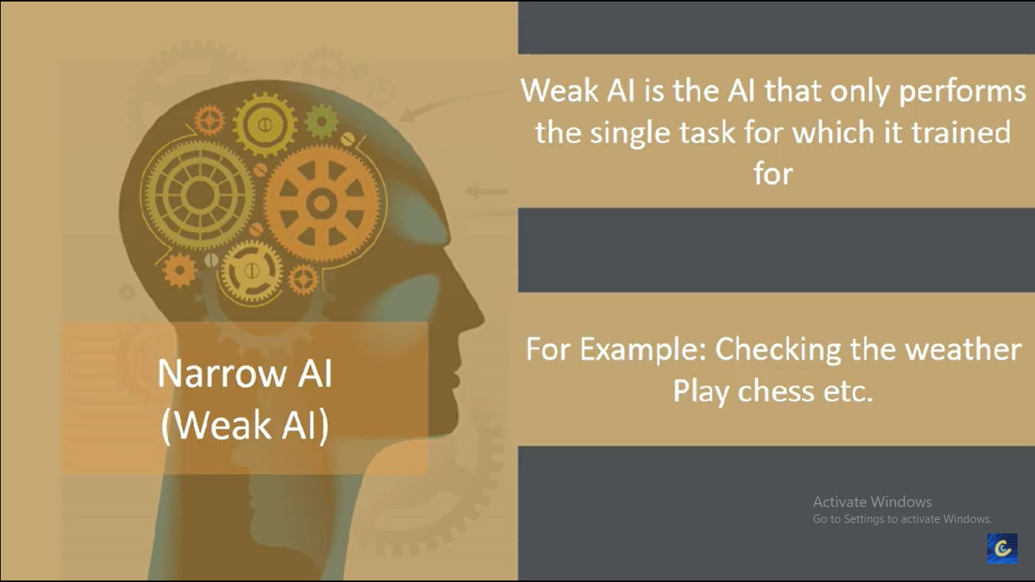
Weak AI

Slide 14
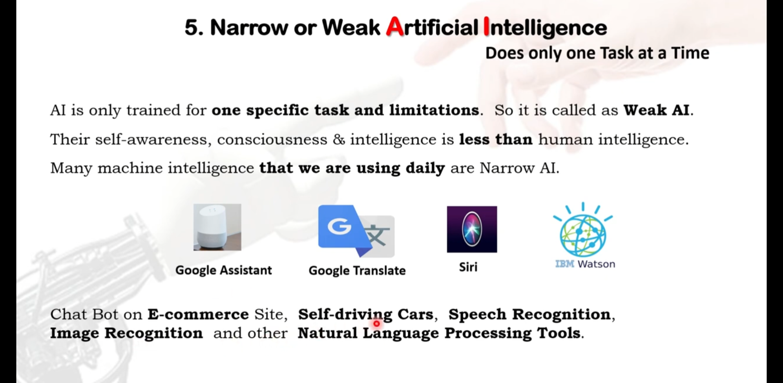
Weak AI

Slide 15
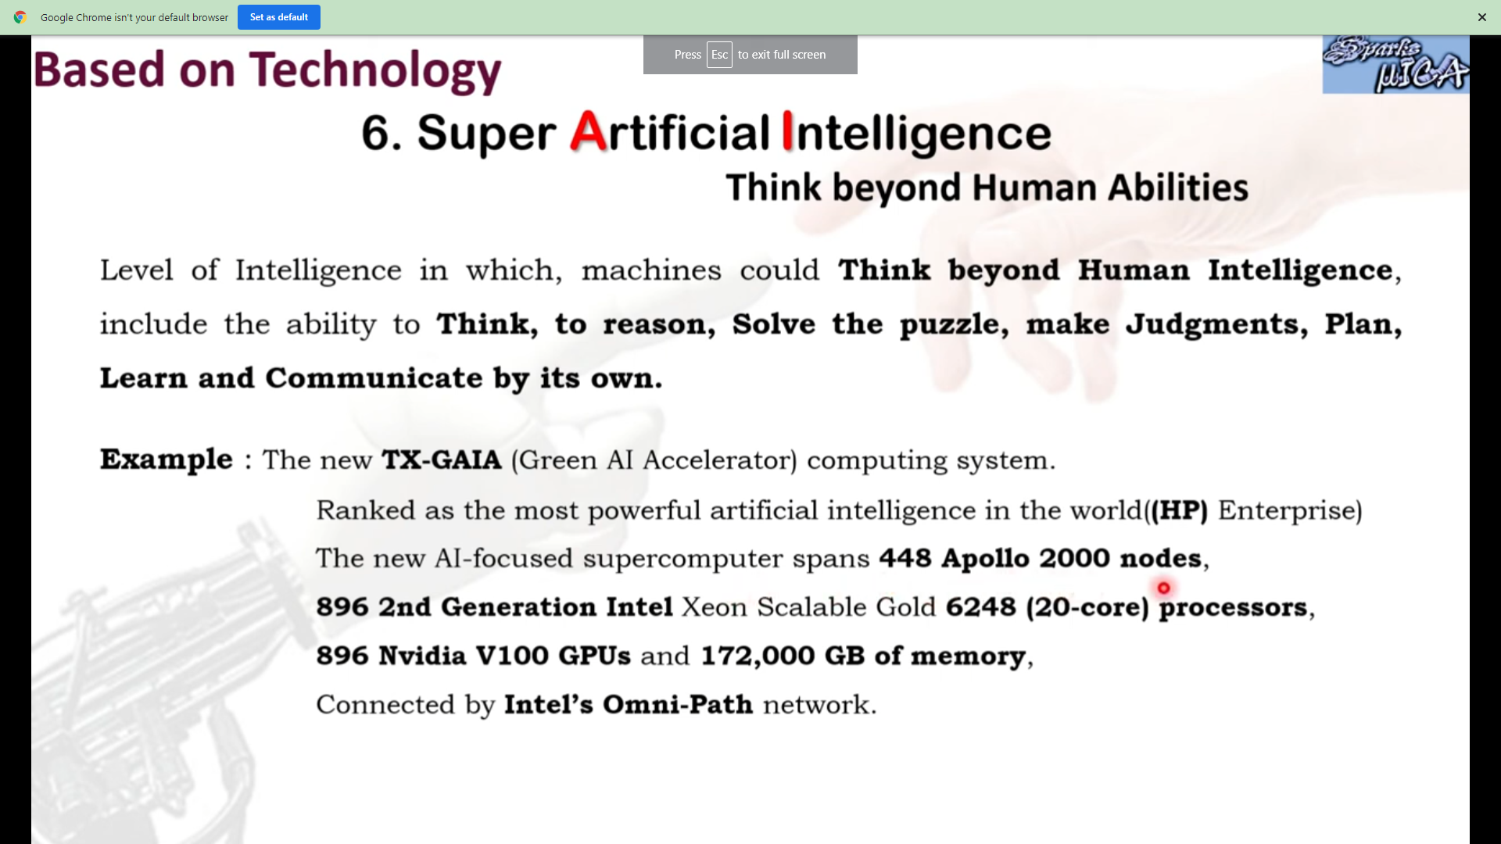

Slide 16
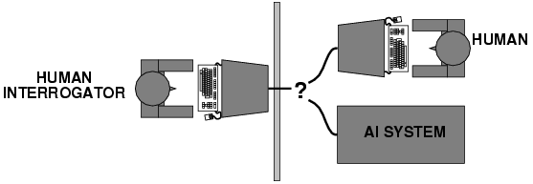
Systems Acting like Humans- Turing Test
Turing (1950) ”Computing machinery and intelligence”.
A computer passes the test if a human interrogator, after posing some written questions, cannot tell whether the written responses come from a person or from a computer.
Necessary components of such a system form major AI sub-disciplines:
Natural language, knowledge representation, automated reasoning, machine learning

Slide 17
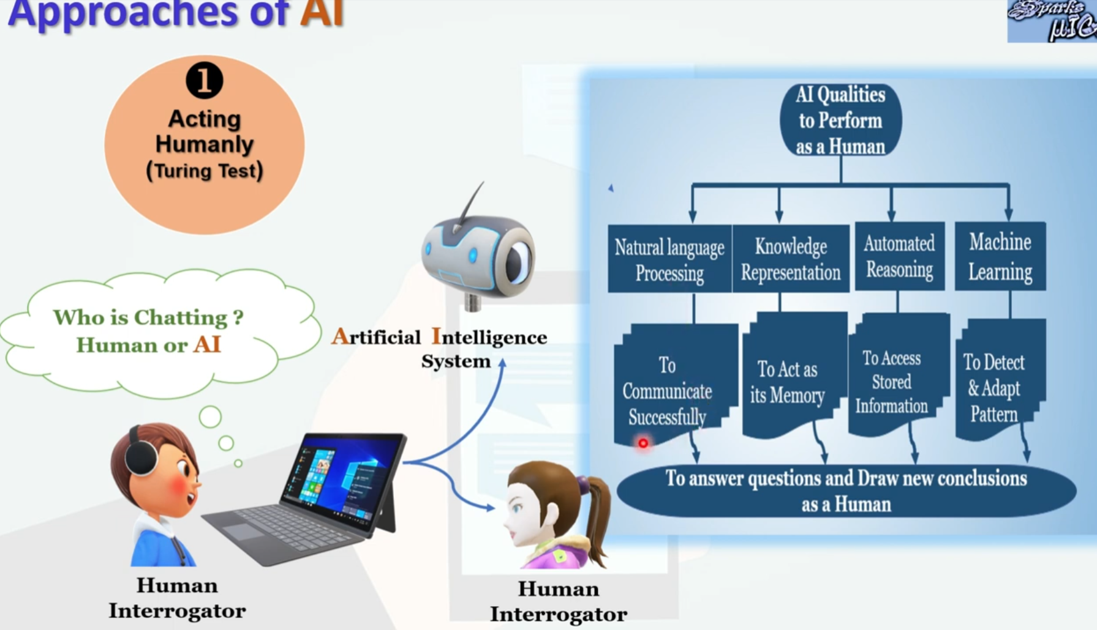
Systems that act like humans (Acting humanly)

Slide 18
Systems that act like humans (Acting humanly) (Turing Machine Test )
The Turing Test, proposed by (Alan Turing -1950)
“This test represent the art of creating machines that perform functions that require intelligence when performed by people.” (Kurzweil-1990)
“This test represent the study of how to make computers do things at which, at the moment, people are better.” (Rich and Knight-1991)
The inability to distinguish computer responses from human responses is called the Turing test

Slide 19
Systems that act like humans (Acting humanly) (Turing Machine Test )
A
B

Slide 20
Systems that act like humans (Acting humanly) (Turing Machine Test )
To conduct this test, we need two people and the machine to be evaluated.
One person plays the role of the interrogator, who is in a separate room from the computer system (AI system) and the other person.
The interrogator can ask questions of either the person or the computer by typing questions and receiving typed responses.
However, the interrogator knows them only as A and B and aims to determine (distinguish) which the person is and which is the machine.

Slide 21
Turing Test
Major Components of Turing Test:
Natural Language Processing: To enable it to communicate successfully in English.
Knowledge Representation: To store what it knows or hears.
Automated Reasoning: To use the stored information to answer questions and to draw conclusions.
Machine Learning: To adapt to new circumstances and to detect and extrapolate patterns.
Total Turing Test also includes:
Computer Vision: To perceive objects
Robotics: To manipulate objects and move about

Slide 22
Thinking Humanly: Cognition
To construct a machines program to think like a human, it require two important things:
first it requires the knowledge about the actual workings of human mind i.e.Formulate a theory of mind/brain.
Express the theory in a computer program
Requires scientific theories of internal activities of the brain.
Cognitive Science: Predicting and testing behavior of human subjects
Cognitive Neuroscience: Direct identification from neurological data

Slide 23
What is Cognitive Science About?
How information is represented, processed, and transformed (in faculties such as perception, language, memory, attention, reasoning, and emotion) within nervous systems (humans or other animals) and machines (e.g. computers).
Cognitive science consists of multiple research disciplines, including psychology, artificial intelligence, philosophy, neuroscience, linguistics, and anthropology.[3] It spans many levels of analysis, from low-level learning and decision mechanisms to high-level logic and planning; from neural circuitry to modular brain organization.
The fundamental concept of cognitive science is that "thinking can best be understood in terms of:
(1) representational structures in the mind and
(2) computational procedures that operate on those structures."[

Slide 24
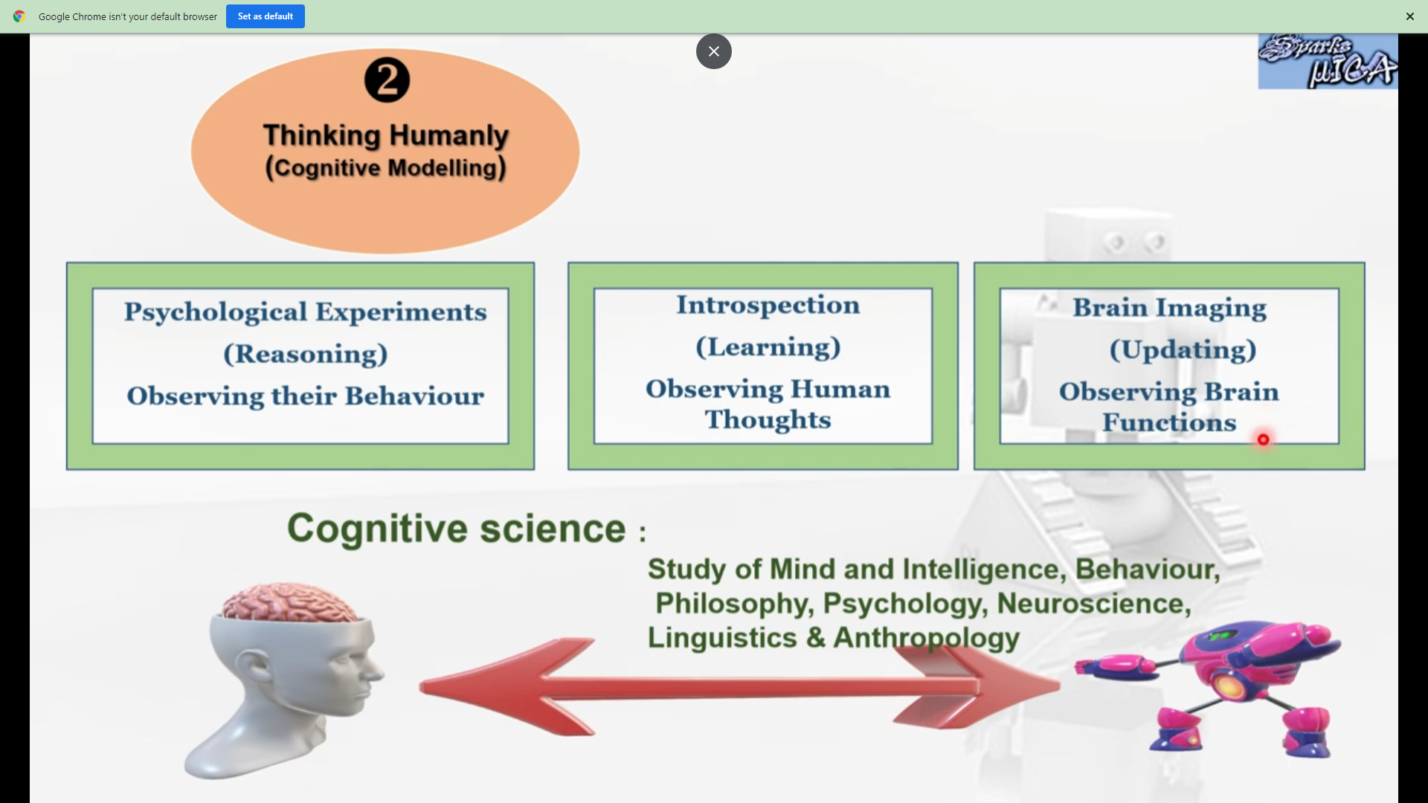
Thinking Humanly: Cognition

Slide 25
Thinking Rationally: “Laws of Thought"
“Rational” -> ideal intelligence
(contrast with human intelligence)
Rational thinking governed by precise “laws of thought”
syllogisms
notation and logic
Systems (in theory) can solve problems using such laws

Slide 26
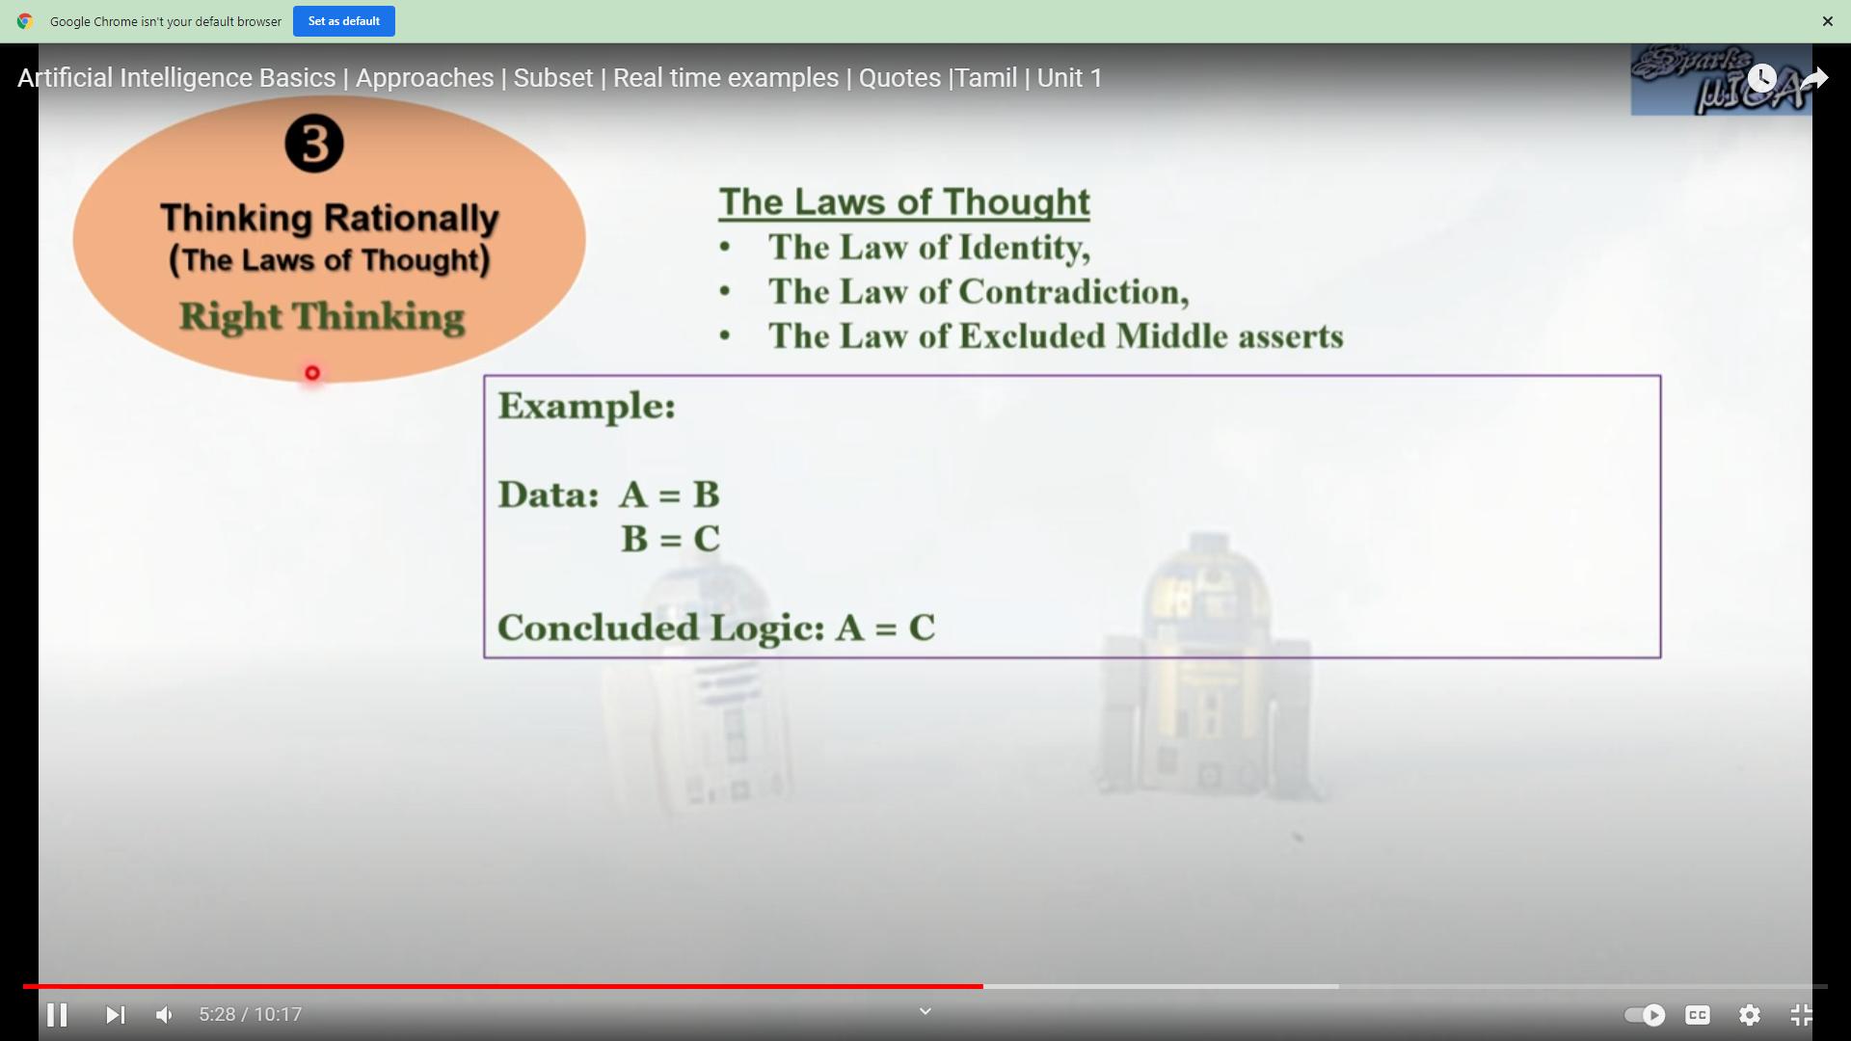
Thinking Rationally

Slide 27
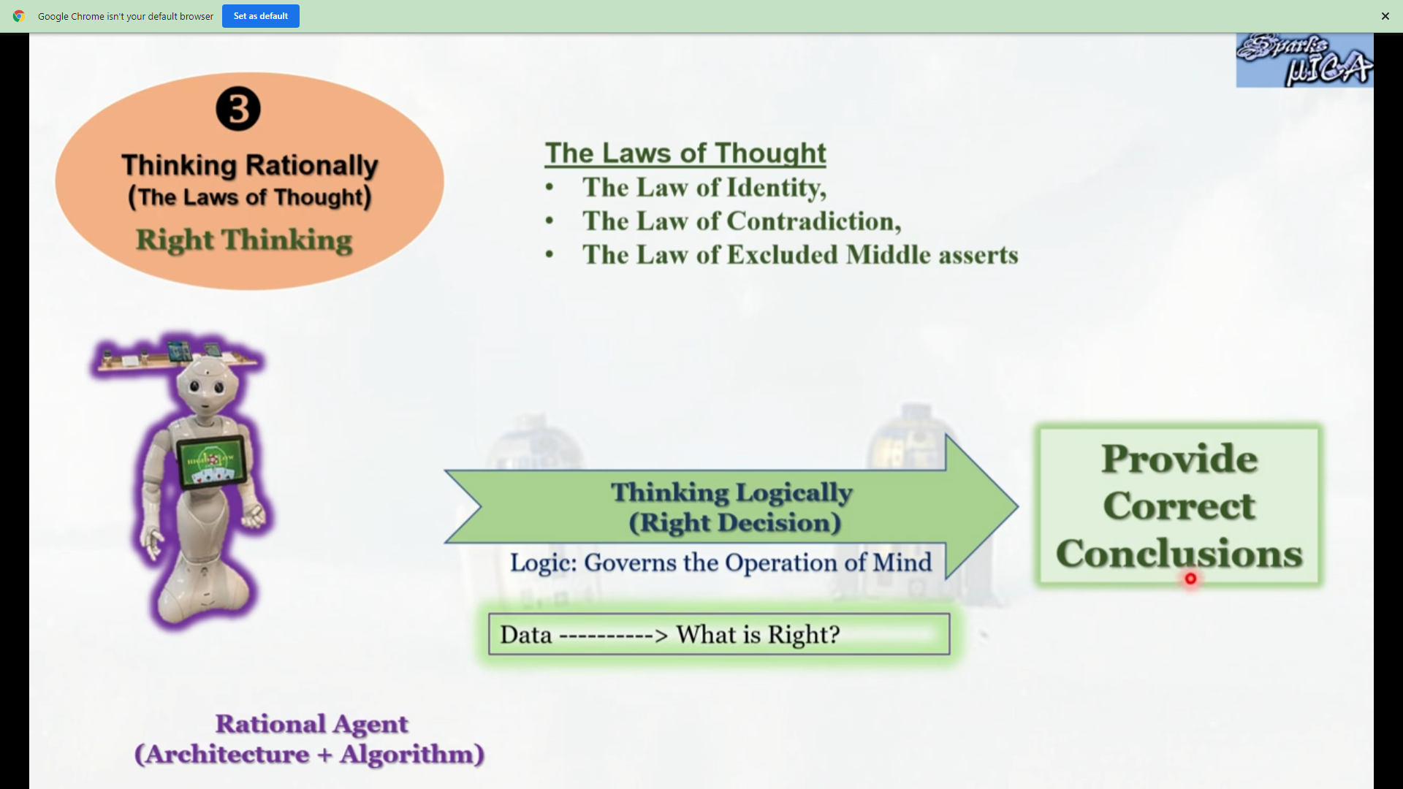
Thinking Rationally

Slide 28
Acting rationally: rational agent
Rational behavior: doing the right thing
The right thing: the optimal (best) thing that is expected to maximize the chances of achieving a set of goals, in a given situation
Building systems that carry out actions to achieve the best outcome

Slide 29
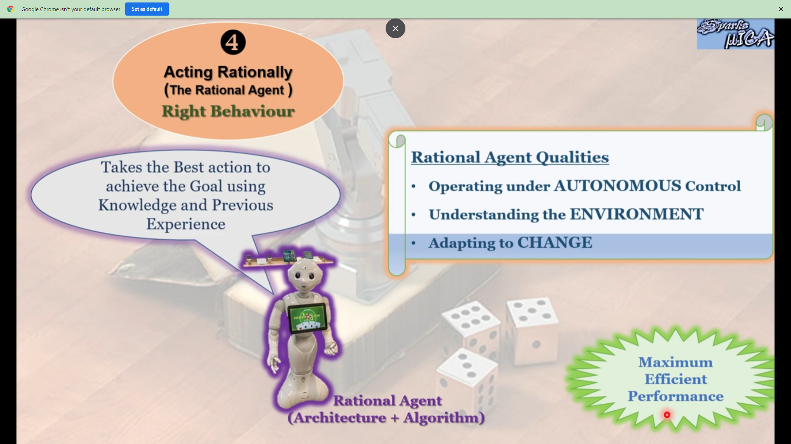
Acting rationally: rational agent

Slide 30
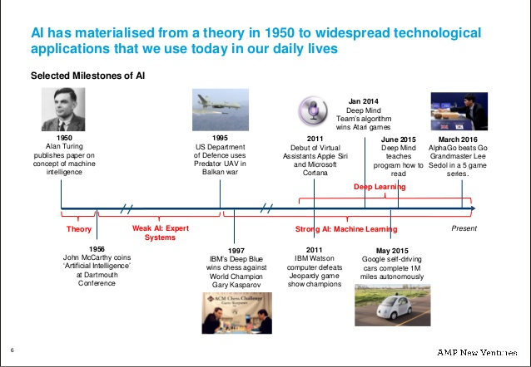

Slide 31
Key research areas in AI
Problem solving, planning, and search --- generic problem solving architecture based on ideas from cognitive science (game playing, robotics).
Knowledge Representation – to store and manipulate information (logical and probabilistic representations)
Automated reasoning / Inference – to use the stored information to answer questions and draw new conclusions
Machine Learning – intelligence from data; to adapt to new circumstances and to detect and extrapolate patterns
Natural Language Processing – to communicate with the machine
Computer Vision --- processing visual information
Robotics --- Autonomy, manipulation, full integration of AI capabilities

Slide 32
History of AI
1943 McCulloch & Pitts: Boolean circuit model of brain
1950 Turing's "Computing Machinery and Intelligence"
1956 Dartmouth: "Artificial Intelligence“ adopted
1952-69 Look, Ma, no hands!
1950s Early AI programs, including Samuel's checkers program, Newell & Simon's Logic Theorist,
1965 Robinson's algo for logical reasoning
1966-73 AI discovers computational complexity Neural network research almost disappears
1969-79 Early development of knowledge-based systems
1980-- AI becomes an industry
1986-- Neural networks return to popularity
1987-- AI becomes a science
1995-- The emergence of intelligent agents.

Slide 33
AI Research Areas
Automation
Expert Systems
Natural Language
Processing
Machine Learning
Artificial Intelligence
Research Areas
Optimization
Neural Networks
Robotics
Fuzzy Logic

Slide 34
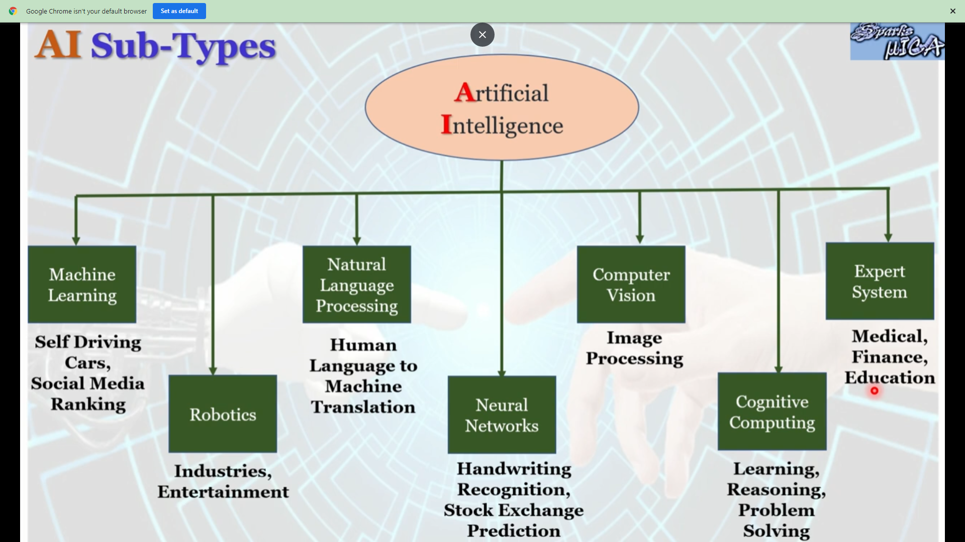
AI Sub Types

Slide 35
Applications of AI
Optical character recognition
Handwriting recognition
Speech recognition
Face recognition
Gaming
Artificial creativity
Computer vision, Virtual reality, and Image processing
Photo and Video manipulation
Diagnosis (artificial intelligence)

Slide 36
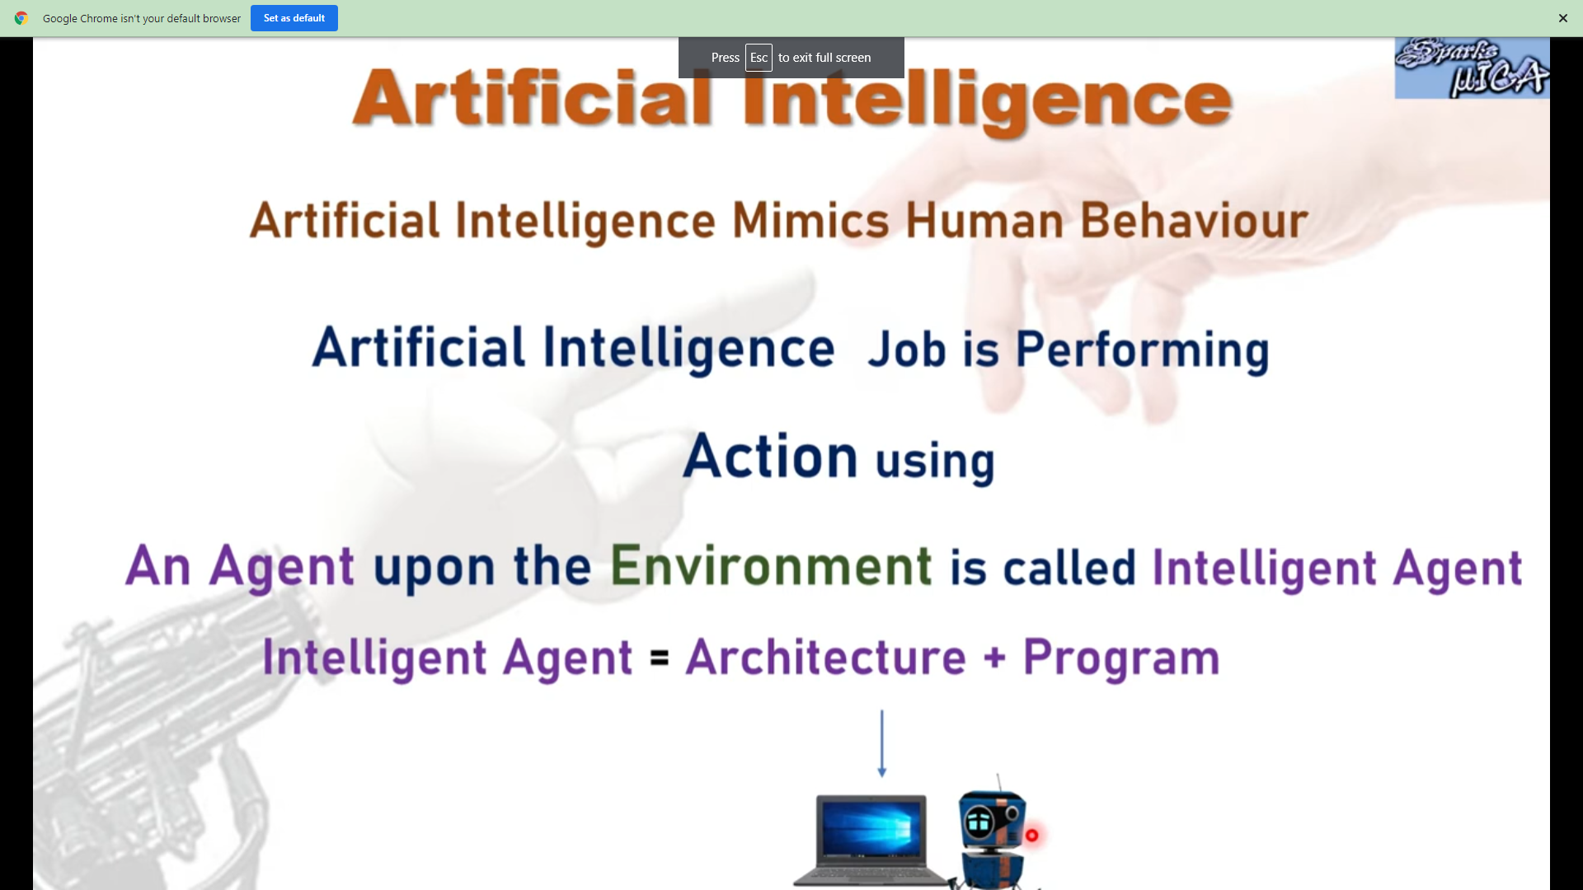
Intellgient Agent

Slide 37
Agents
An agent is anything that can be viewed as perceiving its environment through sensors and acting upon that environment through actuators
Human agent:
Eyes, ears, and other organs for sensors
Hands, legs, mouth, and other body parts for actuators
Robotic agent:
Cameras and infrared range finders for sensors
Various motors for actuators.
Software agent:Software agent can have keystrokes, file contents as sensory input and act on those inputs and display output on the screen

Slide 38
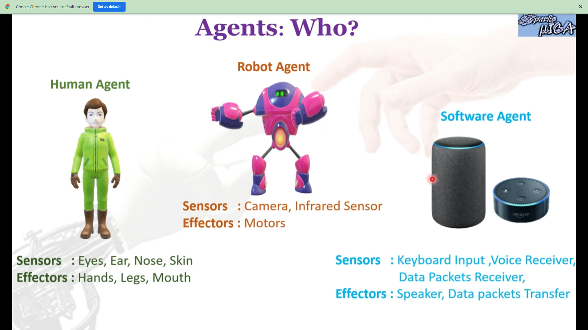

Slide 39
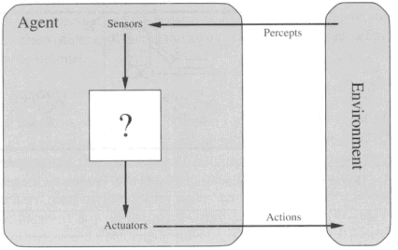
Diagram of an agent
What AI should fill

Slide 40
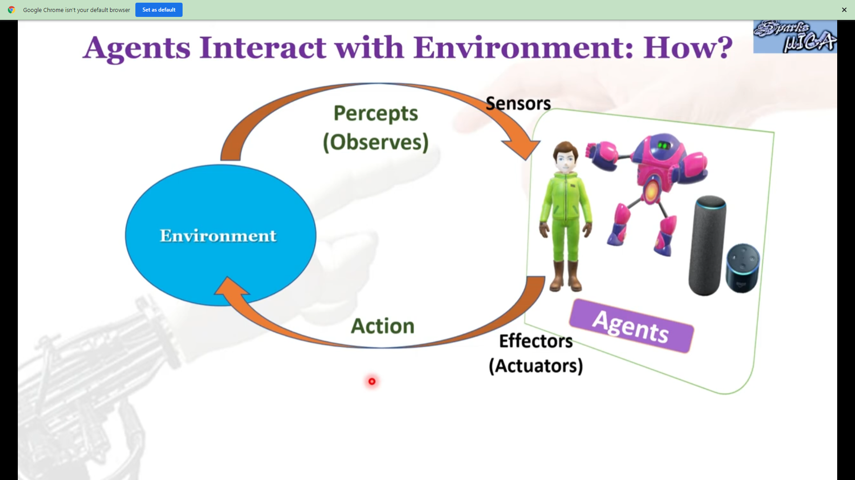

Slide 41
Intelligent Agents
Agent: anything that perceives and acts on its environment
AI: study of rational agents
A rational agent carries out an action with the best outcome after considering past and current percepts
RA – Given all possible outcomes our RA should try to provide best outcome.

Slide 42
Agent function & program
Agent’s behavior is mathematically described by
Agent function
A function mapping any given percept sequence to an action
Practically it is described by
An agent program
The real implementation

Slide 43
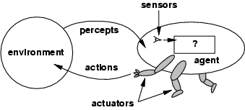
Agents and Environments
The agent function maps from percept histories to actions:
[f: P* → A]
The agent program runs on the physical architecture to produce f
Agent = architecture + program

Slide 44
Agent Function
a = F(p)
where p is the current percept, a is the action carried out, and F is the agent function
F maps percepts to actions F: P → A
where P is the set of all percepts, and A is the set of all actions
In general, an action may depend on all percepts observed so far, not just the current percept, so…

Slide 45
Structure of Agents
Agent = architecture + program
architecture
device with sensors and actuators
e.g., A robotic car, a camera, a PC, …
program
implements the agent function on the architecture

Slide 46
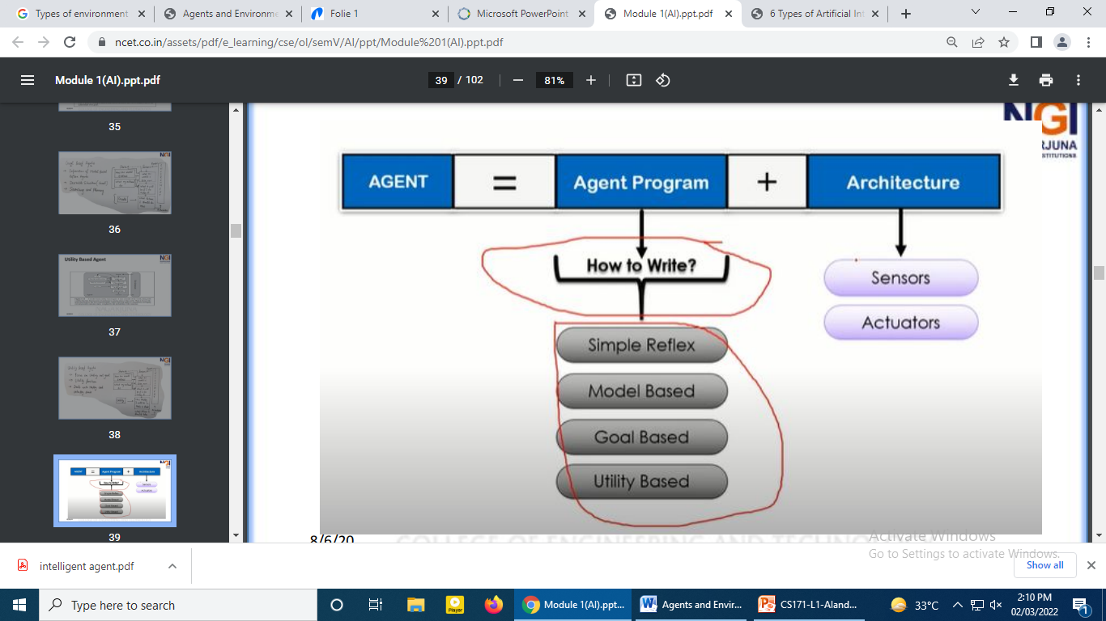
Agent

Slide 47
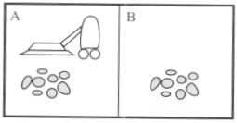
Vacuum-cleaner world
Perception: Clean or Dirty? where it is in?
Actions: Move left, Move right, suck, do nothing

Slide 48
Agents and Environments
Example: Vacuum Cleaner World
Two locations: squares A and B
Perceives what square it is in
Perceives if there is dirt in the current square
Actions
move left
move right
suck up the dirt
do nothing
A
B

Slide 49
Agents and Environments
Agent Function: Vacuum Cleaner World
If the current square is dirty, then suck, otherwise move to the other square
Percept Sequence | Action
[A, Clean] | Right
[A, Dirty] | Suck
[B, Clean] | Left
[B, Dirty] | Suck
[A, Clean], [A, Clean] | Right
[A, Clean], [A, Dirty] | Suck

Slide 50

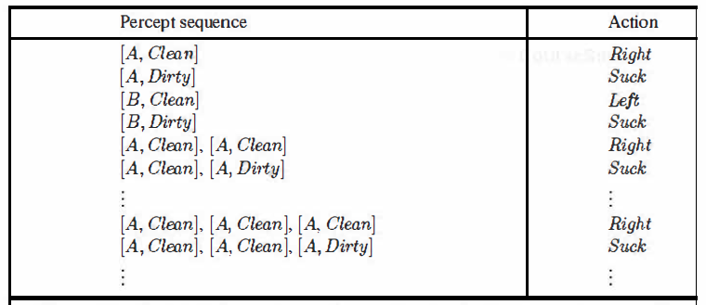
Vacuum-cleaner World
Percepts: location and contents, e.g., [A,Dirty]
Actions: Left, Right, Pick_Dirt, NoOp

Slide 51
Program implements the agent function tabulated in Fig. 2.3
Function Reflex-Vacuum-Agent([location,status]) return an action
If status = Dirty then return Suck
else if location = A then return Right
else if location = B then return left

Slide 52
Rationality – Performance Measure
An agent should strive to "do the right thing", based on what it can perceive and the actions it can perform
The right action is the one that will cause the agent to be most successful
Performance measure: An objective criterion for success of an agent's behavior
E.g., performance measure of a vacuum-cleaner agent could be amount of dirt cleaned up, amount of time taken, amount of electricity consumed, amount of noise generated, etc.

Slide 53
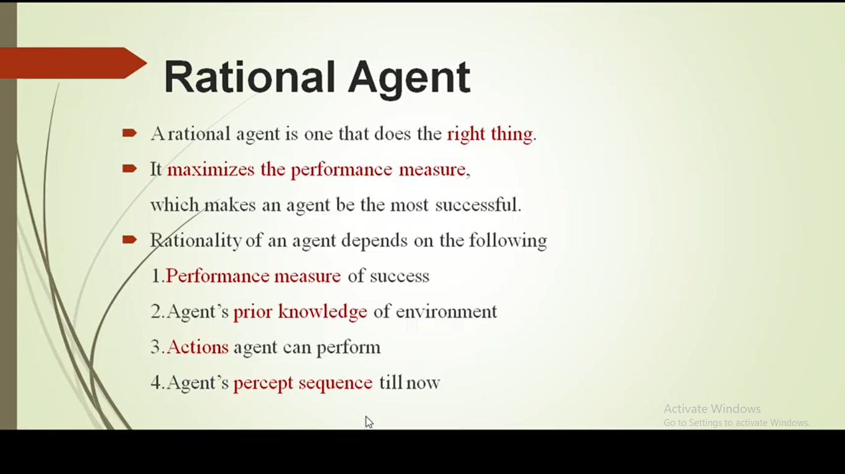
Rational Agent

Slide 54
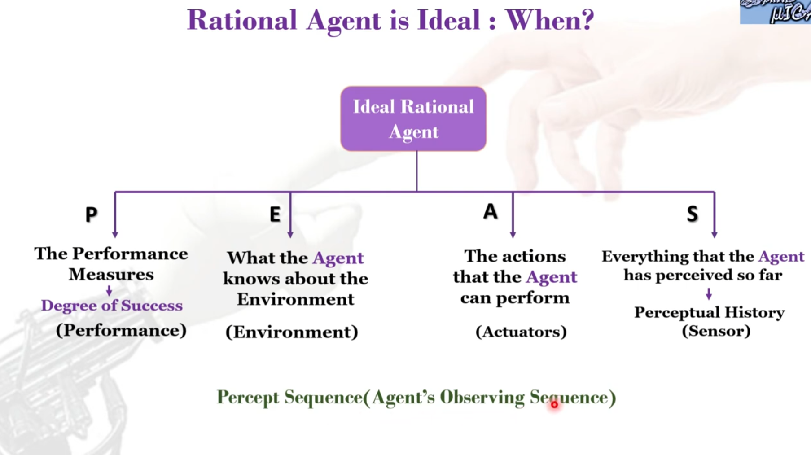
Rational Agent

Slide 55
Rational Agent - Role
Rational Agent: For each possible percept sequence, a rational agent should select an action that is expected to maximize its performance measure, given the evidence provided by the percept sequence and whatever built-in knowledge the agent has
We can also use the term “optimizing the performance measure”.

Slide 56
PEAS
PEAS: Performance measure, Environment, Actuators, Sensors
Must first specify the setting for intelligent agent design
Consider, e.g., the task of designing an automated taxi driver:
Performance measure: Safe, fast, legal, comfortable trip, maximize profits
Environment: Roads, other traffic, pedestrians, customers
Actuators: Steering wheel, accelerator, brake, signal, horn
Sensors: Cameras, sonar, speedometer, GPS, odometer, engine sensors, keyboard.

Slide 57
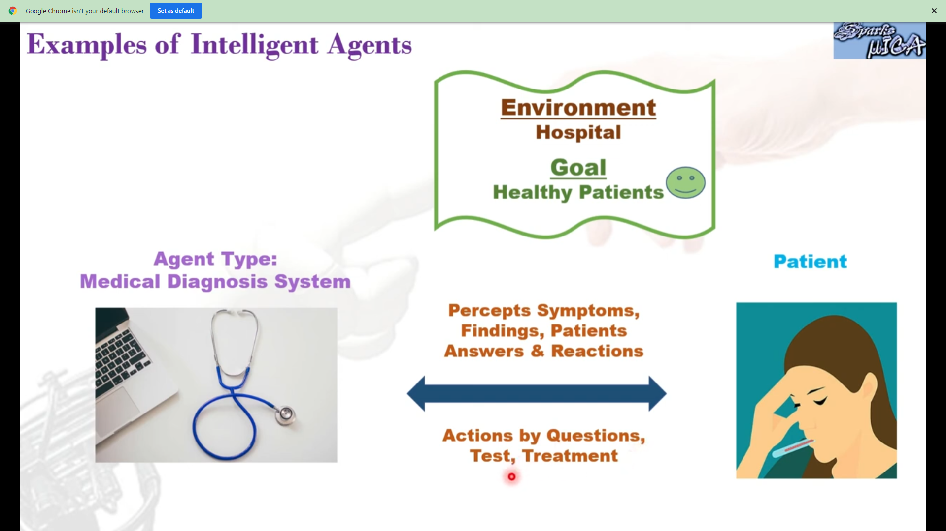
Examples

Slide 58
PEAS
Agent: Medical Diagnosis System
Performance measure: Healthy patient, minimize costs, lawsuits
Environment: Patient, hospital, staff
Actuators: Screen display (questions, tests, diagnoses, treatments, referrals)
Sensors: Keyboard (entry of symptoms, findings, patient's answers).

Slide 59
PEAS
Agent: Part-picking robot
Performance measure: Percentage of parts in correct bins
Environment: Conveyor belt with parts, bins
Actuators: Jointed arm and hand
Sensors: Camera, joint angle sensors.

Slide 60
PEAS
Agent: Interactive English tutor
Performance measure: Maximize student's score on test
Environment: Set of students
Actuators: Screen display (exercises, suggestions, corrections)
Sensors: Keyboard.

Slide 61
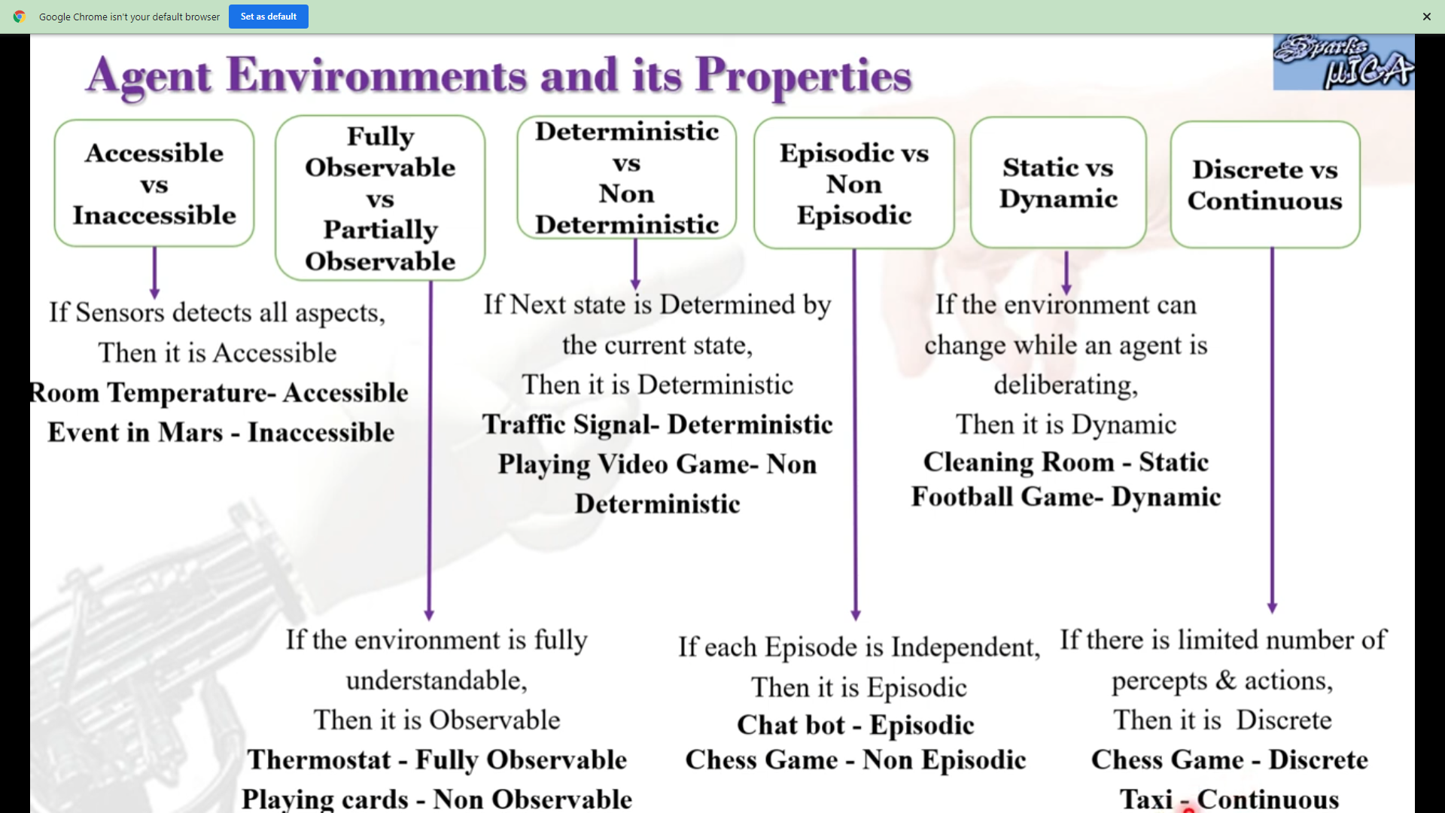
Agent Environments

Slide 62
Environment Types
The environment type largely determines the agent design
The real world is (of course) partially observable, stochastic, sequential, dynamic, continuous, multi-agent.

Slide 63
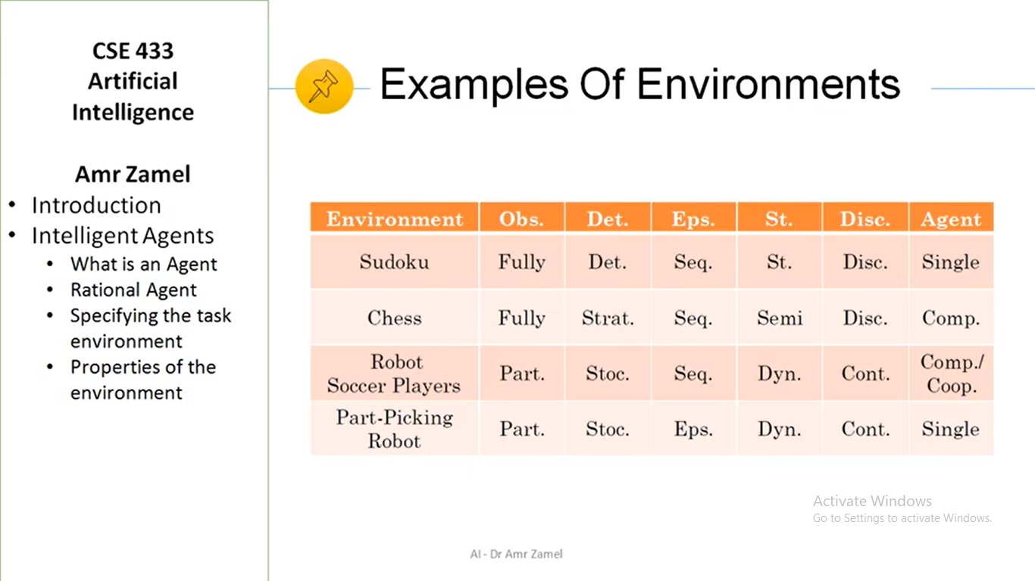

Slide 64
Environment Types
Fully Observable (vs. Partially Observable): An agent's sensors give it access to the complete state of the environment at each point in time
In FO, the agent can be confident that it requires nothing more in order to decide on the optimal action
PO can be due to faulty sensors
If we are driving along a stretch of road that we know well, and if dust enters our eyes, we are still able to drive on the route with blinking eyes (partial observation)
PO requires the agent to have an internal representation of the state.

Slide 65
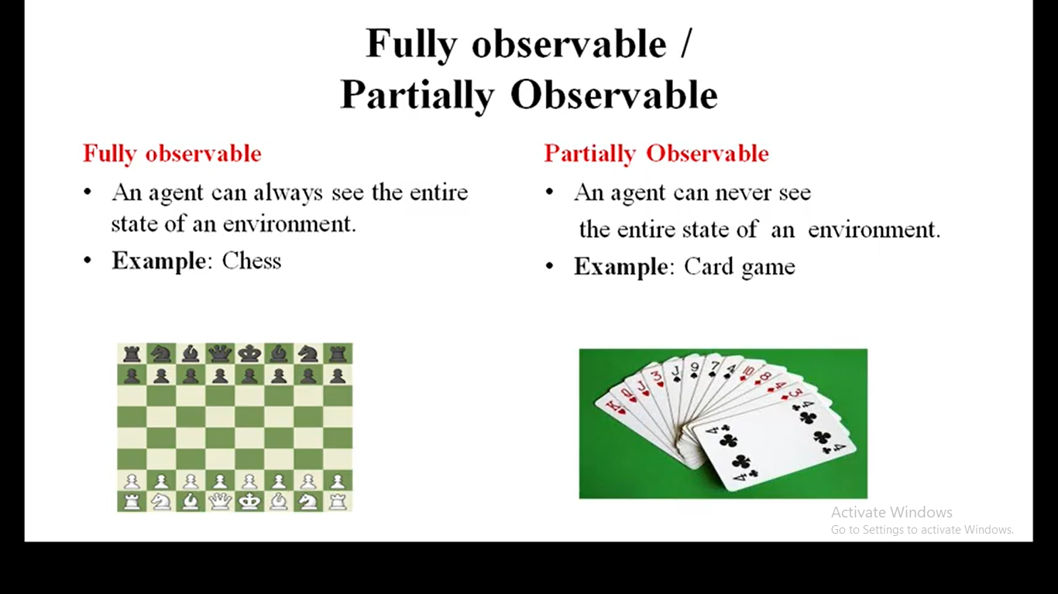

Slide 66
Environment Types
Deterministic (vs. Stochastic): The next state of the environment is completely determined by the current state and the action executed by the agent
Stochastic (Non-Deterministic): There can be more than one next state, for a given state-action combination
Taxi Driving is clearly stochastic
Consider a Multi-agent environment
If the environment is deterministic except for the actions of other agents, then the environment is strategic
Strategy Games.

Slide 67
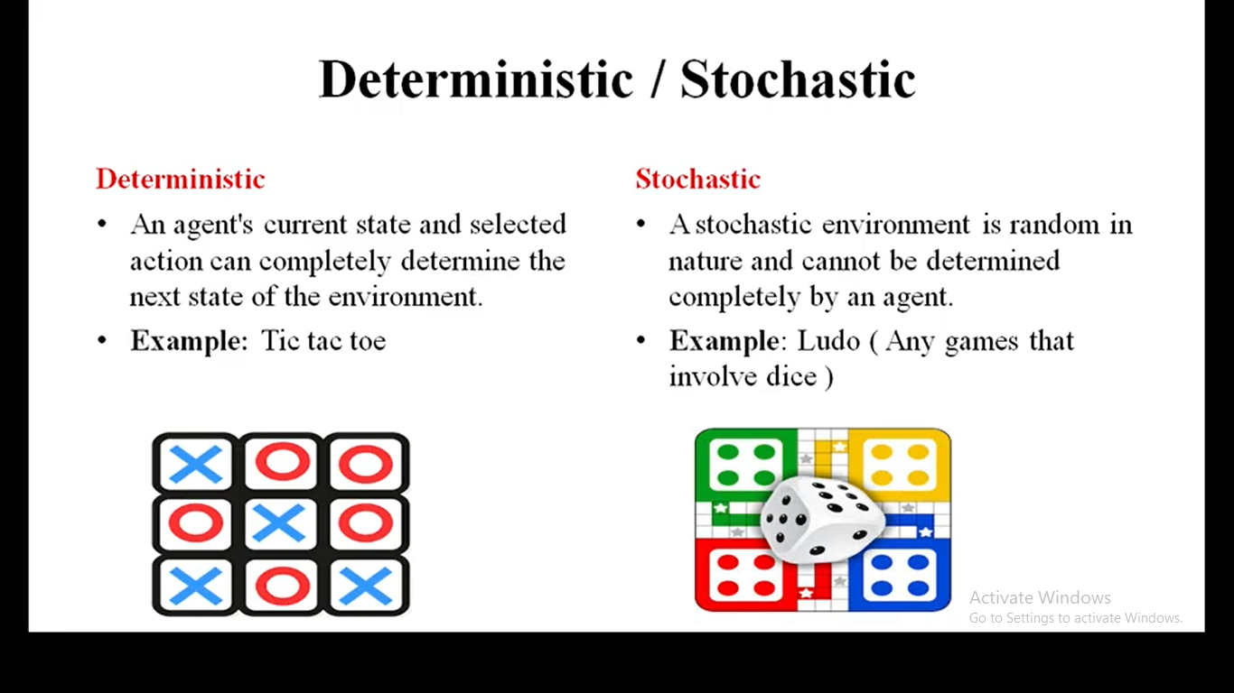

Slide 68
Environment Types
Episodic (vs. sequential): The agent's experience is divided into atomic "episodes”
Each episode consists of the agent perceiving and then performing a single action, and the choice of action in each episode depends only on the episode itself, e.g., a robot whose job is to detect faulty parts on a line in some factory
In a sequential setting, the next episode depends on the previous one(s), e.g., learning which chess move to execute at each sequential step, in order to win the game at the end
Also called a sequential decision process.

Slide 69
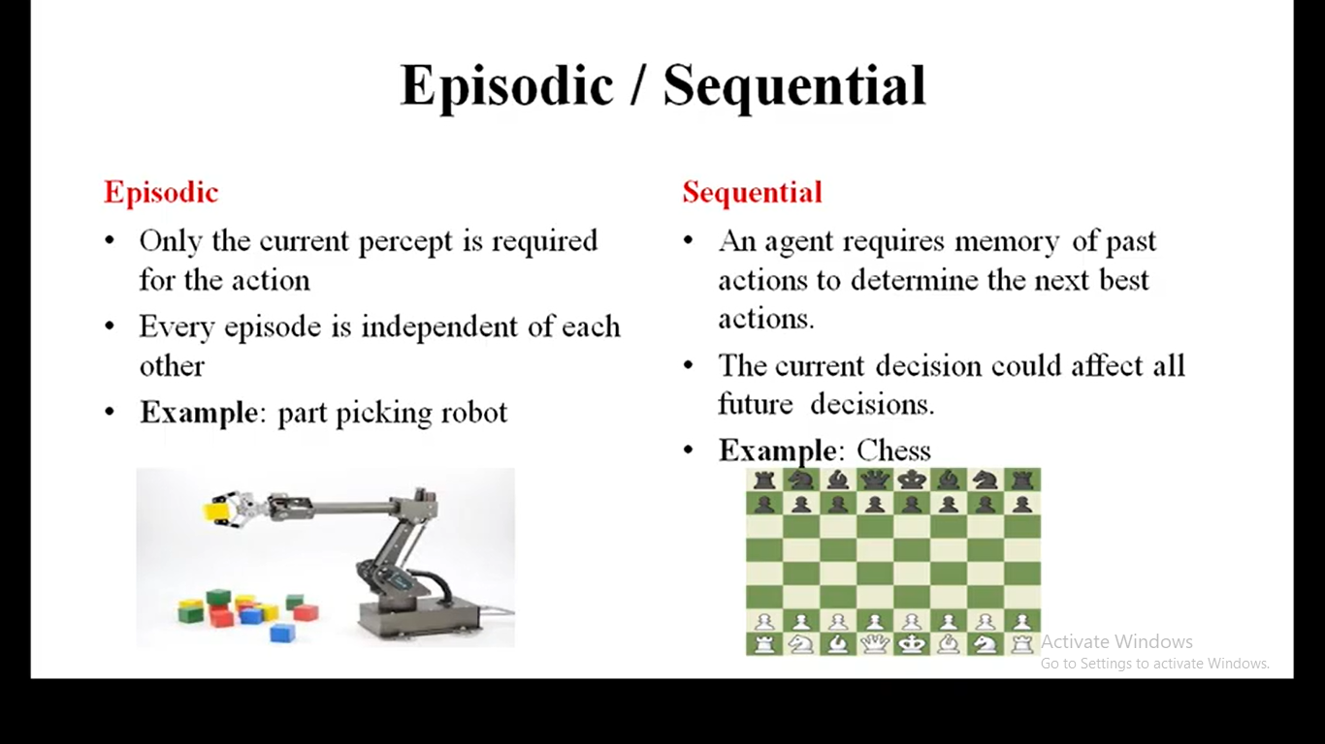

Slide 70
Environment Types
Static (vs. Dynamic): The environment is unchanged while an agent is deliberating which action to execute
Much more simpler to deal with
For the dynamic case, the agent needs to keep track of the changes
The environment is semi-dynamic if the environment itself does not change with the passage of time but the agent's performance score does, e.g., checkers.
Discrete (vs. Continuous): The environment is discrete if the number of actions and possible states of the environment is finite otherwise it is continuous.

Slide 71
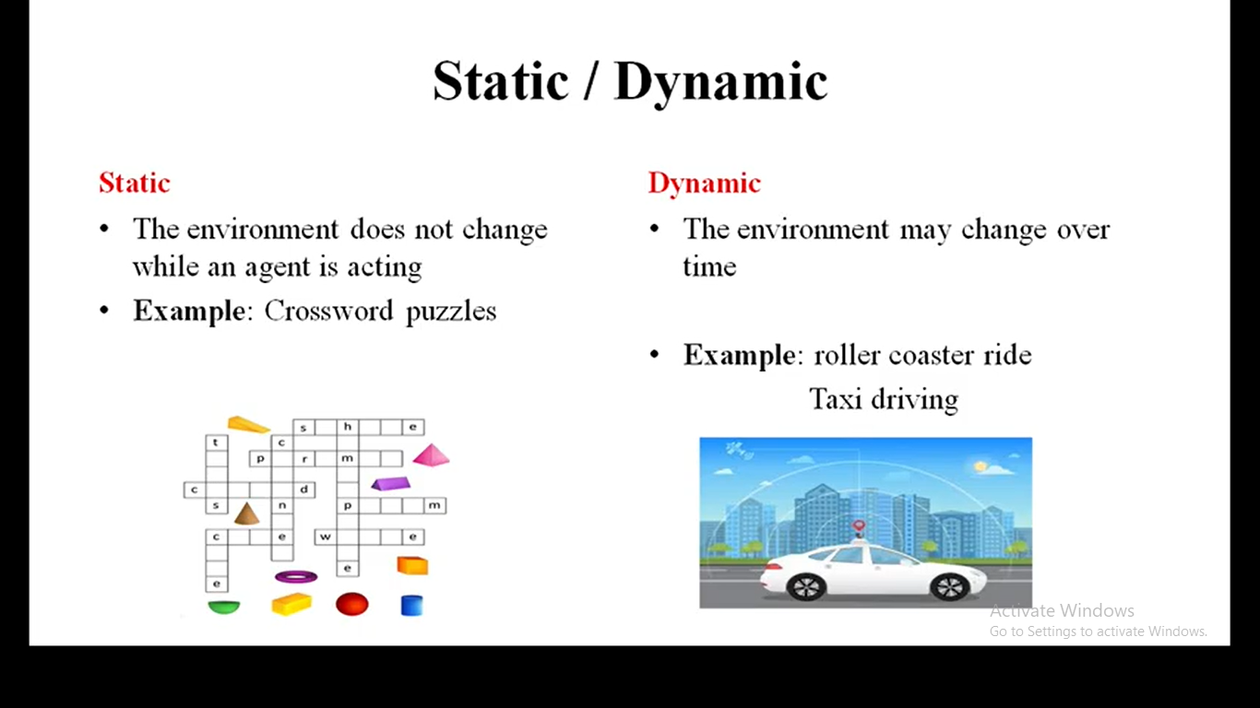

Slide 72
Environment Types
Single Agent (vs. Multi-Agent): An agent operating by itself in an environment
In the multi-agent case, the performance measure of one agent depends on the performance measures of the other agent(s)
Competitive multi-agent: Chess Playing
Collaborative multi-agent: Robo Soccer.
A quite complicated field which is currently the focus of much research.

Slide 73
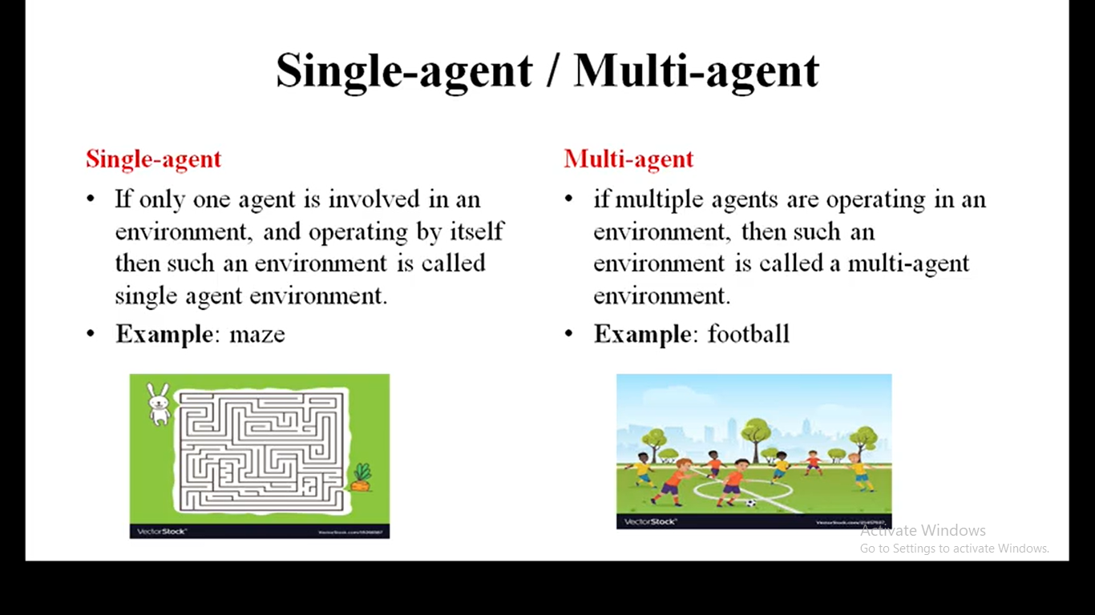

Slide 75
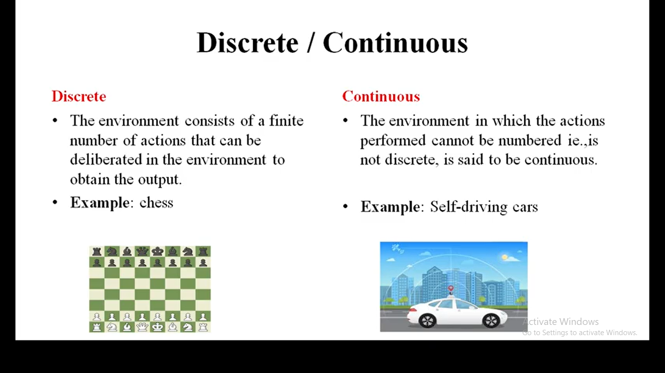

Slide 76
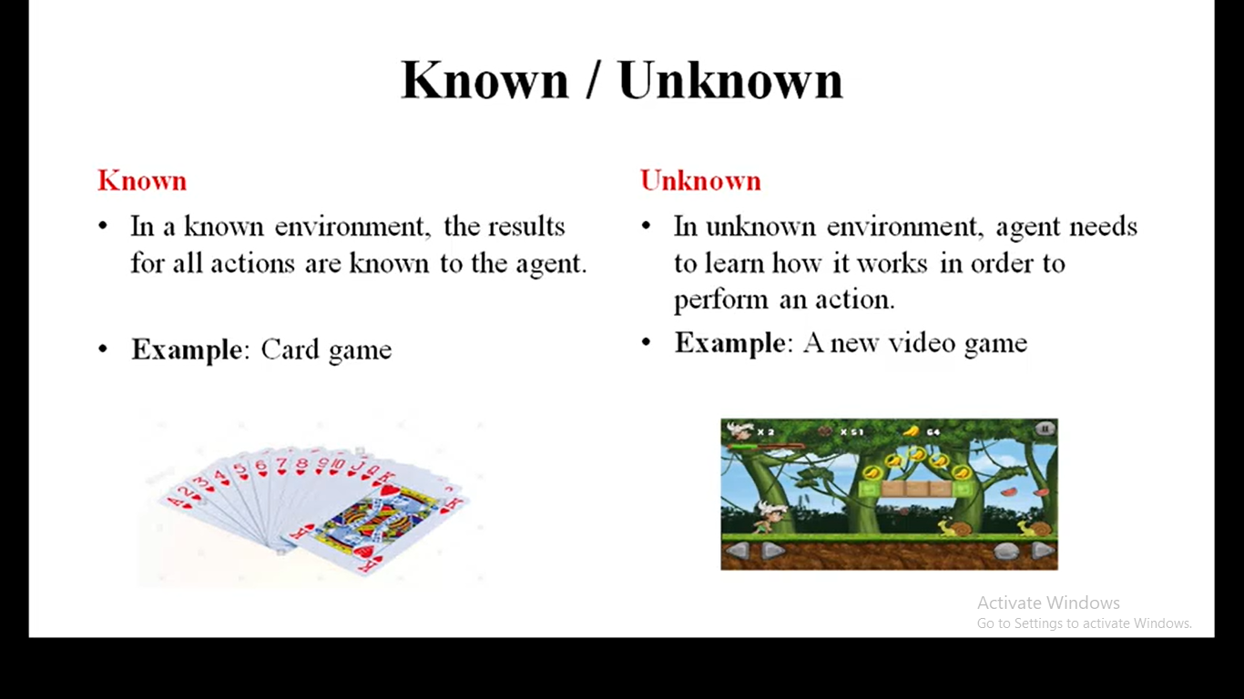

Slide 77
Agent Functions and Programs
An agent is completely specified by the agent function that maps percept sequences to actions
Can also be labeled as the strategy of the agent
There could be many possible agent functions
Aim: Discover the most rational (optimal) agent function.

Slide 78
Table-lookup Agent
Simplest possible agent function:
All possible states and their optimal actions specified by the designers in advance
Drawbacks:
Huge table (consider continuous states)
Could take a long time to build the table
No autonomy!
Even with learning, agent could need a long time to learn the table entries.

Slide 79
Agent types
Four basic types in order of increasing generality:
Simple Reflex agents
Model-based Reflex agents
Goal-based agents
Utility-based agents
And Finally: Learning agents

Slide 80
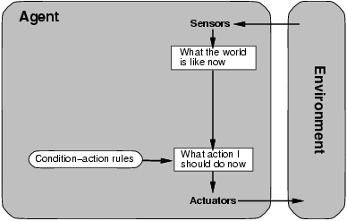
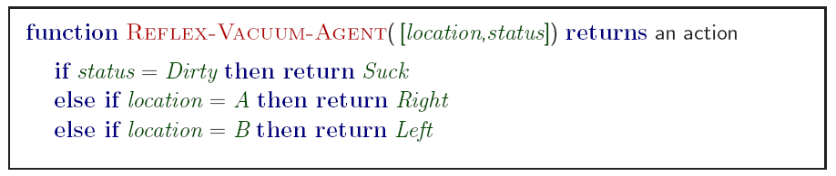
Simple Reflex Agents
Applies condition-action rules based only on the current input (reflex)

Slide 81
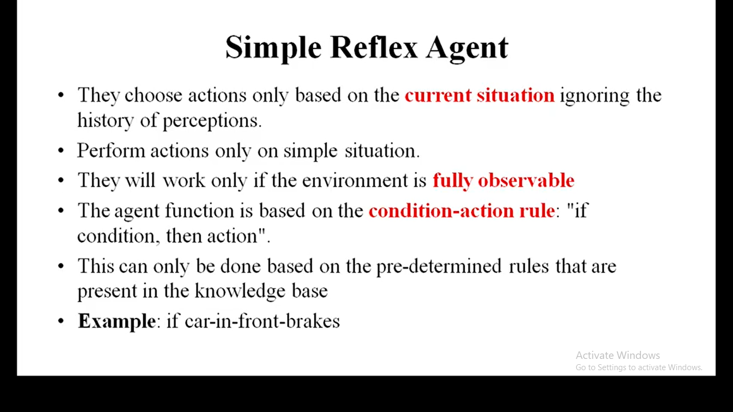
Notes:
https://www.youtube.com/watch?v=L2CKvo14k64&list=PLbhdEzRraaeGjIhuP96wB3L2BTBhaOeWe&index=5

Slide 82
Simple Reflex agents
Simple but very limited intelligence.
Agent selects actions on the basis
of current percept only.
Agents do not have memory of past world states or percepts.
So, actions depend solely on current percept.
Action becomes a “reflex.”
Uses condition-action rules.
Action does not depend on percept history, only on current percept.
Therefore no memory requirements.
Infinite loops
Suppose vacuum cleaner does not observe location. What do you do given location = clean? Left of A or right on B -> infinite loop.
Notes:
Another example: fly buzzing against window.

Slide 83
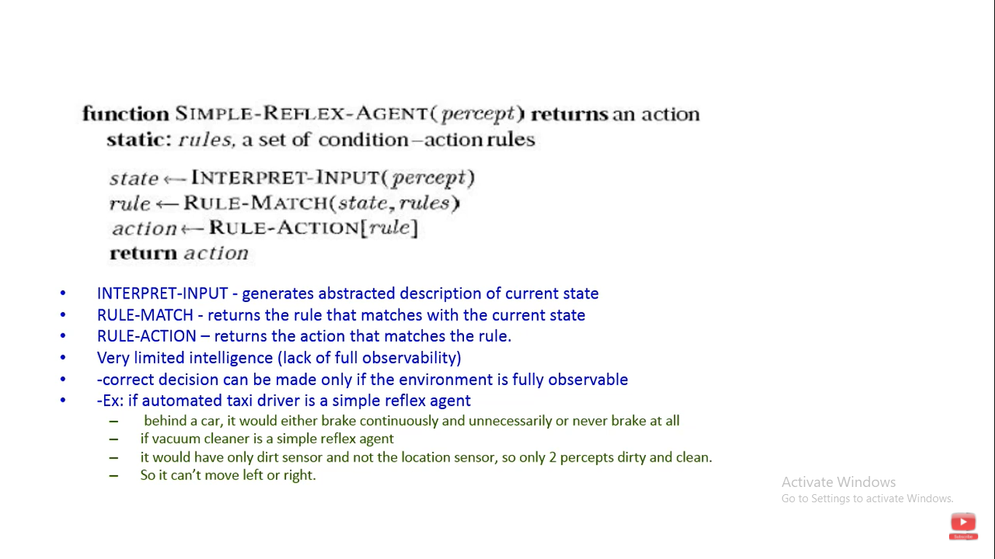

Slide 84
Simple Reflex agents
Automated Taxi:
Agent observes rain falling on the windshield: Agent powers on the viper
Agent observes a red signal; Agent breaks the taxi until it stops.

Slide 85
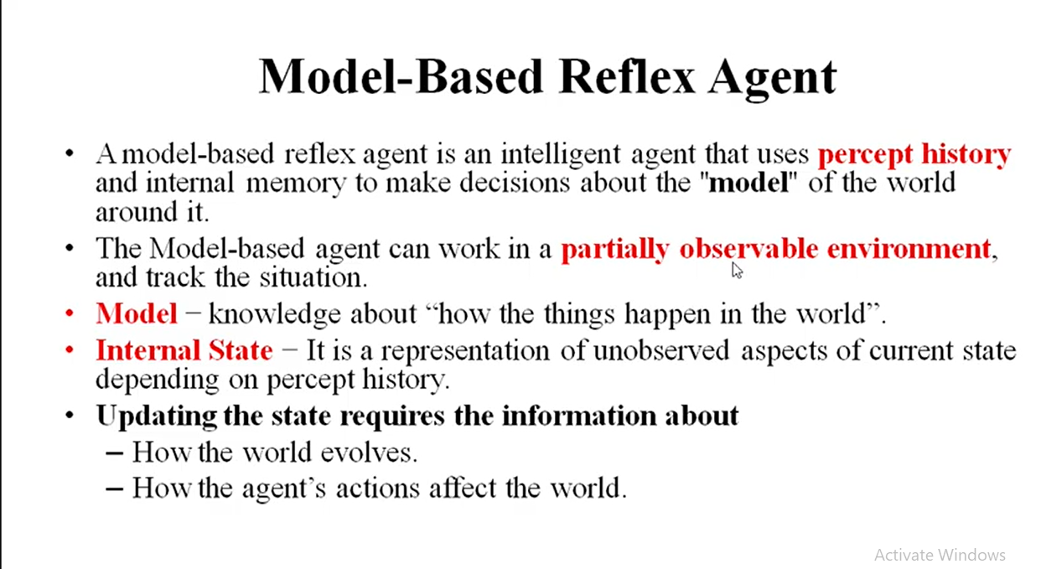
Model Based Reflex Agent

Slide 86
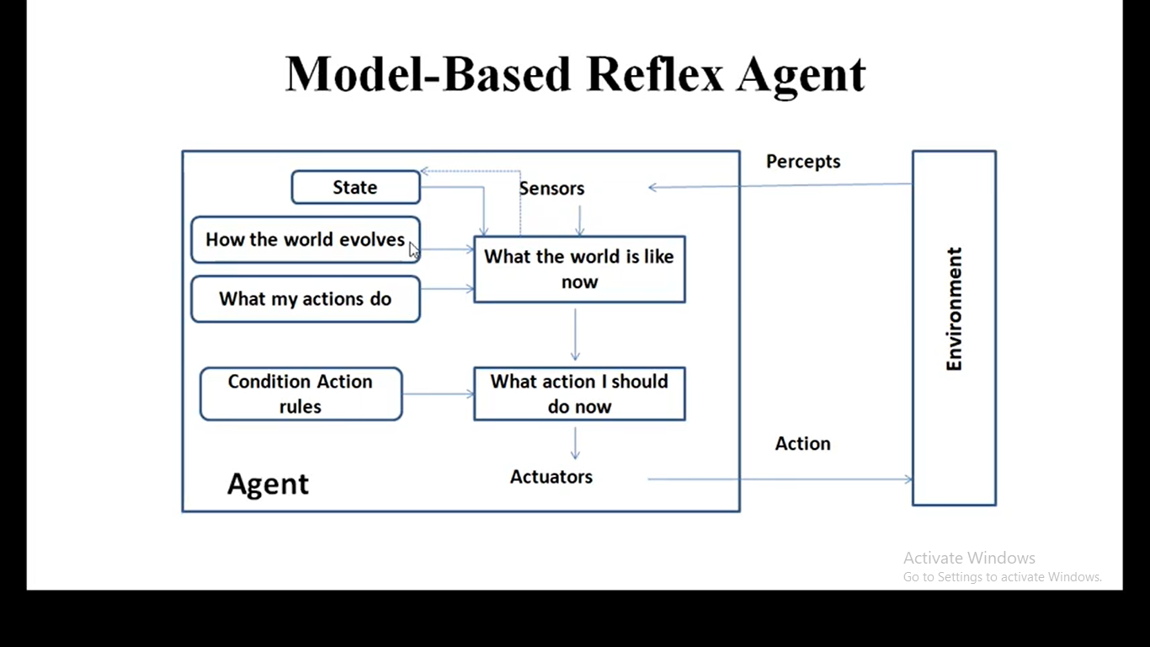

Slide 87
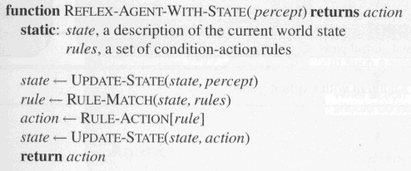
Model-based Reflex Agents
The agent is with memory

Slide 88
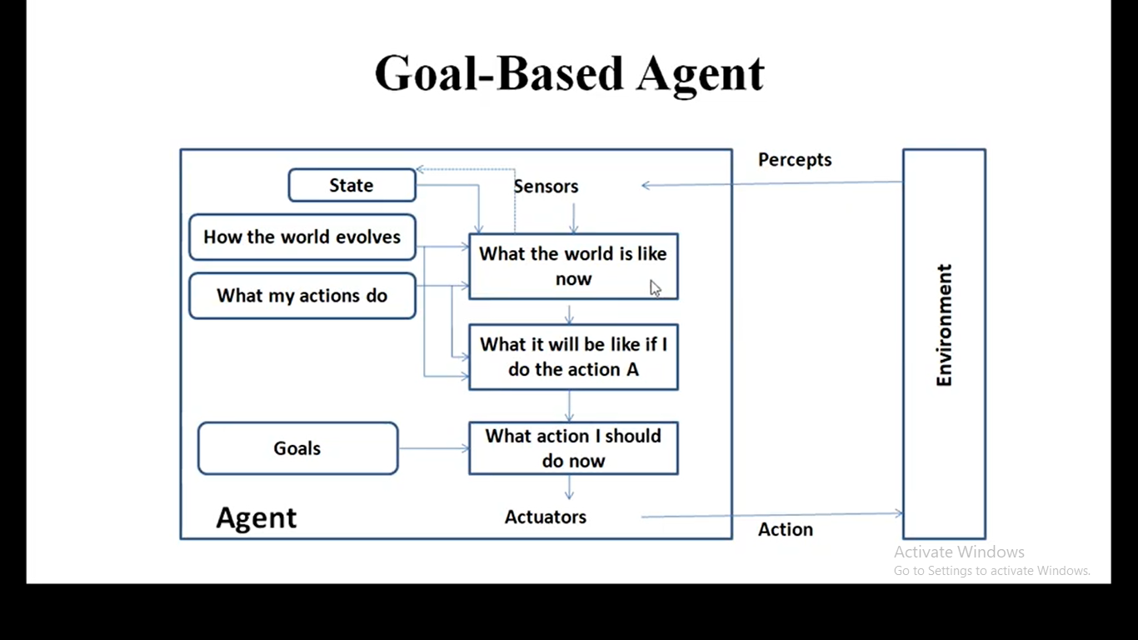
Goal-based agents

Slide 89
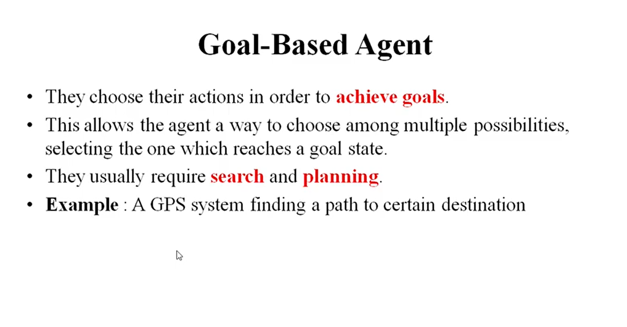

Slide 90
Goal-based Agents
Automated Taxi:
Consider the agent at a crossing, where it can turn right, left, or go straight
Using the model, the Agent can understand the consequences of turning left, right or going straight ahead
All 3 might seem the optimal actions to take
However, the agent needs to select one of these actions in order to reach the destination of the passenger.

Slide 91
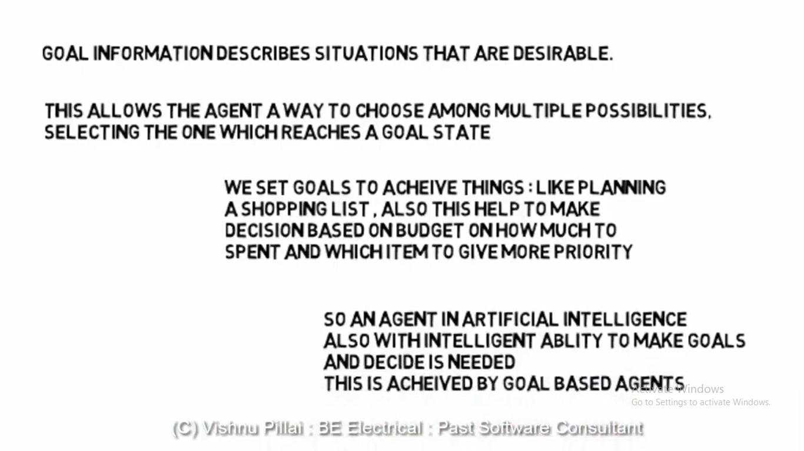

Slide 93
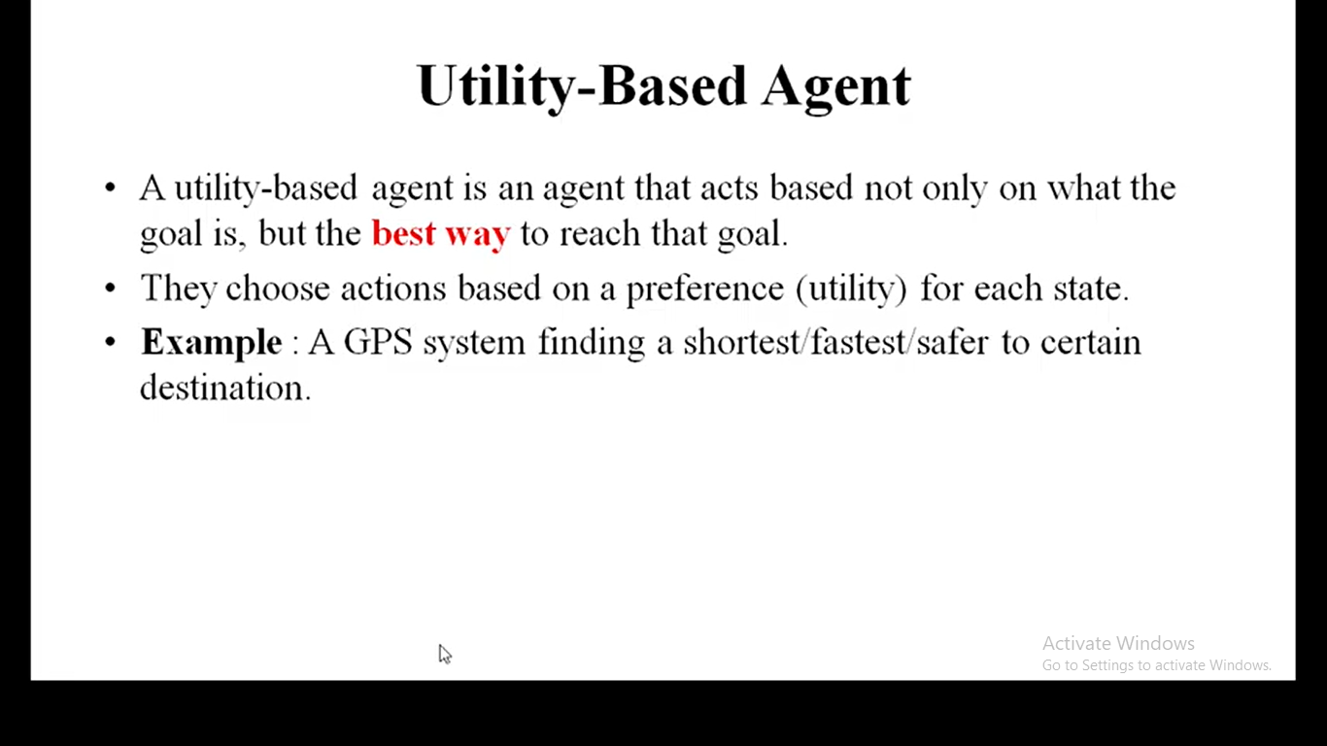

Slide 94
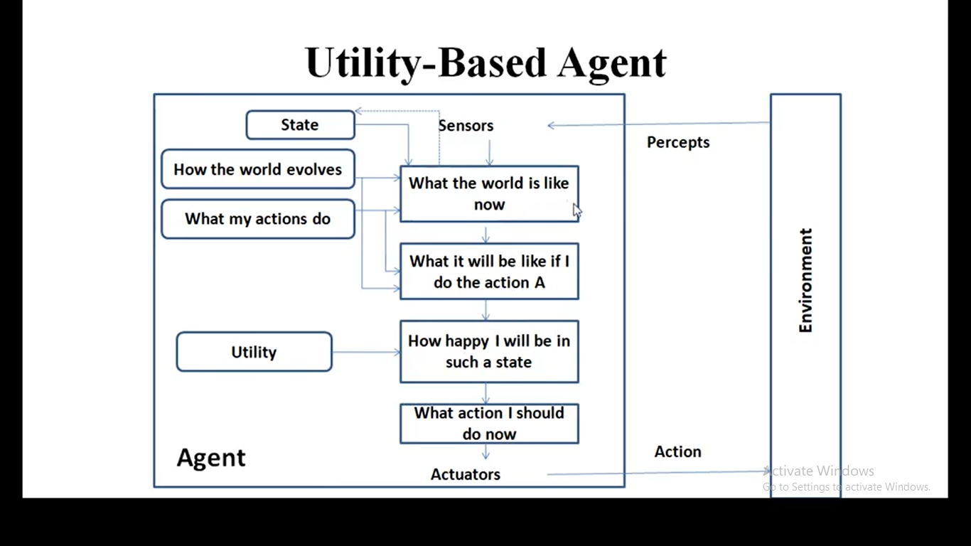
Utility-based agents

Slide 95
Utility-based agents
Goals are not always enough
Many action sequences get taxi to destination
Consider other things. How fast, how safe…..
A utility function maps a state onto a real number which describes the associated degree of “happiness”, “goodness”, “success”.
Where does the utility measure come from?
Economics: money.
Biology: number of offspring.
Your life?
Notes:
Example: why is it important to get a good grade in this course?

Slide 96
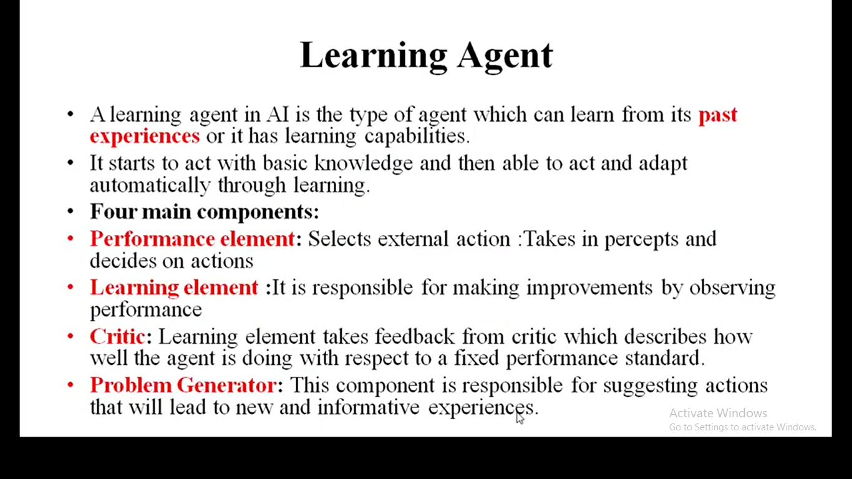
Learning Agent

Slide 97
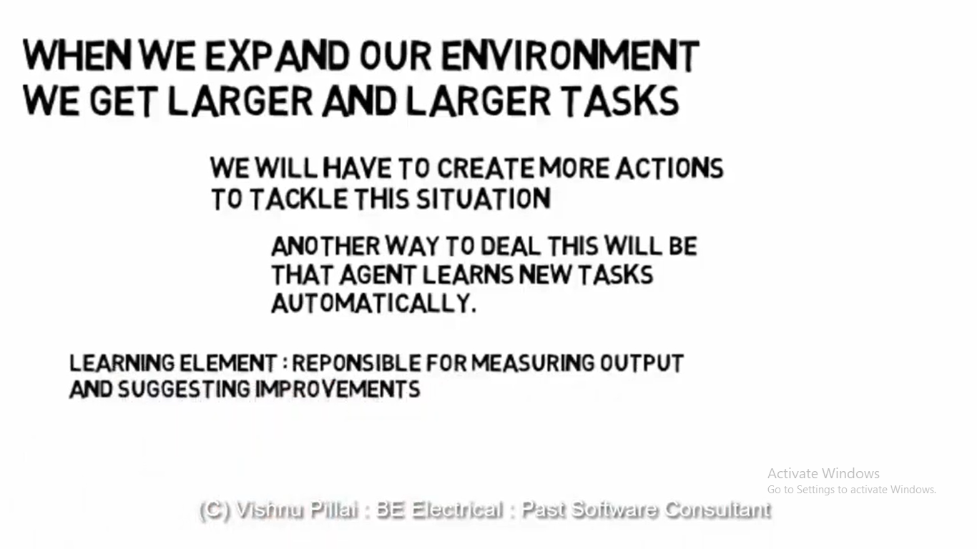

Slide 98
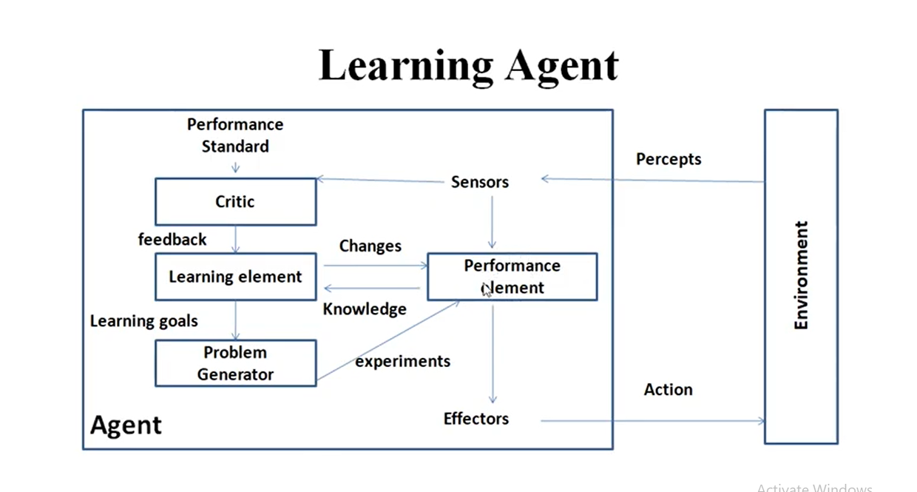

Slide 100
Learning agents(Taxi driver)
Performance element
How it currently drives
Taxi driver Makes quick left turn across 3 lanes
Critics observe shocking language by passenger and other drivers and informs bad action
Learning element tries to modify performance elements for future
Problem generator suggests experiment out something called Brakes on different Road conditions
Exploration vs. Exploitation
Learning experience can be costly in the short run
shocking language from other drivers
Less tip
Fewer passengers

Slide 101
Summary: agent types
(1) Table-driven agents
use a percept sequence/action table in memory to find the next action. They are implemented by a (large) lookup table.
(2) Simple reflex agents
are based on condition-action rules, implemented with an appropriate production system. They are stateless devices which do not have memory of past world states.
(3) Agents with memory - Model-based reflex agents
have internal state, which is used to keep track of past states of the world.
(4) Agents with goals – Goal-based agents
are agents that, in addition to state information, have goal information that describes desirable situations. Agents of this kind take future events into consideration.
(5) Utility-based agents
base their decisions on classic axiomatic utility theory in order to act rationally.
(6) Learning agents
they have the ability to improve performance through learning.

Slide 102
Summary
An agent perceives and acts in an environment, has an architecture, and is implemented by an agent program.
A rational agent always chooses the action which maximizes its expected performance, given its percept sequence so far.
An autonomous agent uses its own experience rather than built-in knowledge of the environment by the designer.
An agent program maps from percept to action and updates its internal state.
Reflex agents (simple / model-based) respond immediately to percepts.
Goal-based agents act in order to achieve their goal(s), possible sequence of steps.
Utility-based agents maximize their own utility function.
Learning agents improve their performance through learning.
Representing knowledge is important for successful agent design.
The most challenging environments are partially observable, stochastic, sequential, dynamic, and continuous, and contain multiple intelligent agents.

Slide 103
Summary
Agents can be described by their PEAS.
Environments can be described by several key properties: 4 Environment Types.
A rational agent maximizes the performance measure for their PEAS.
The performance measure depends on the agent function.
The agent program implements the agent function.
3 main architectures for agent programs.
In this course we will look at some of the common and useful combinations of environment/agent architecture.

Slide 104

Questions

